Slide 1
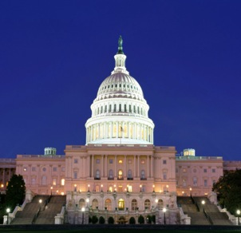
Brand USA 50 States, 5 Territories, 1 United Effort
October 2012 – Keri Hanson, Brand USA, @LeighBlaize

Slide 2
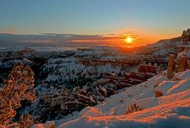
Global Marketing Partner
to the Travel Industry
Promote the United States as a premier travel destination
Established by the Travel Promotion Act
Partner investments matched with ESTA funds (Electronic System for Travel Authorization) required by Visa Waiver Program (not taxpayer dollars)

Slide 3
Funding Model
Private sector funding is required to receive ESTA funds
Cash or in-kind investment
Minimum cash requirement is 20%, and in-kind can be up to 80%, but not required
$1 from cash or in-kind contribution
$1 matching funds received from ESTA funds
Up to $100M to support marketing the USA as a premier travel destination
Advertising
Sponsorships
Co-op Marketing
Licensing
Publications
Joint Media Buys
Trade Shows
Funded by $14 fee paid to ESTA by travelers from 36 visa waiver countries
The marketing fund created by the ESTA fee is capped at $100M annually

Slide 4
Roles in the Travel Industry
TRAVEL & TOURISM INDUSTRY
PROMOTE
ADVOCATE
Lead the Nation’s global marketing effort
Communicate US entry and security processes
Create a welcoming experience for International tourists
Advocate for policies to remove travel barriers
Communicate benefits of Travel to policymakers
Provide industry networking opportunities
ADVISE
Advise the Secretary of Commerce on Issues Affecting the Travel Industry

Slide 5
Strong and Growing Partnerships
Founding Partners at the $1 million contribution level and above include:
Reached our FY2012 goal for cash contributions
More than half of our goal for in-kind contributions

Slide 6
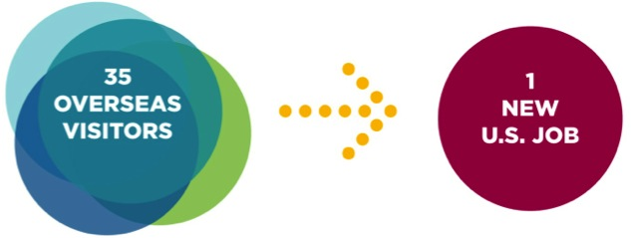
To Seize the Moment
Global travel is booming – expected to double to $2.1 trillion by 2020
Arrivals to the United States expected to increase 36% from 59.7 million travelers in 2010 to 81 million travelers in 2016
Equates to an additional $88 billion in revenues and 629,000 jobs
33 TRAVELERS

Slide 7
Behavioral Objectives by Cluster

Slide 8
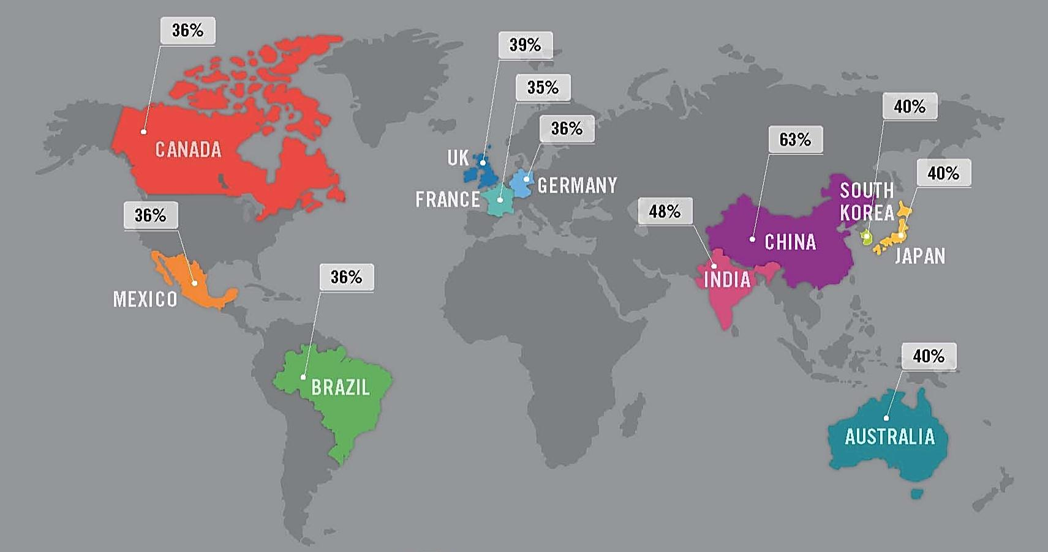
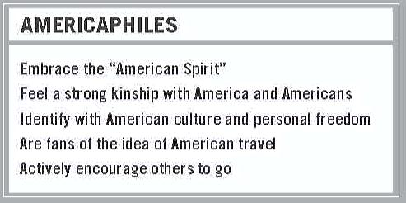
Americaphiles Strongly Represented in Key Markets
Source: JWT Sonar Proprietary Quantitative Study (August 2011)
Population: CIA World Factbook Data (July 2011)

Slide 9
Our International Visitor Target
Upscale Americaphiles
215 Million Across
Our 16 Key Core Markets
(8% of those aged 15+)
Source: JWT Sonar and qualitative studies

Slide 10
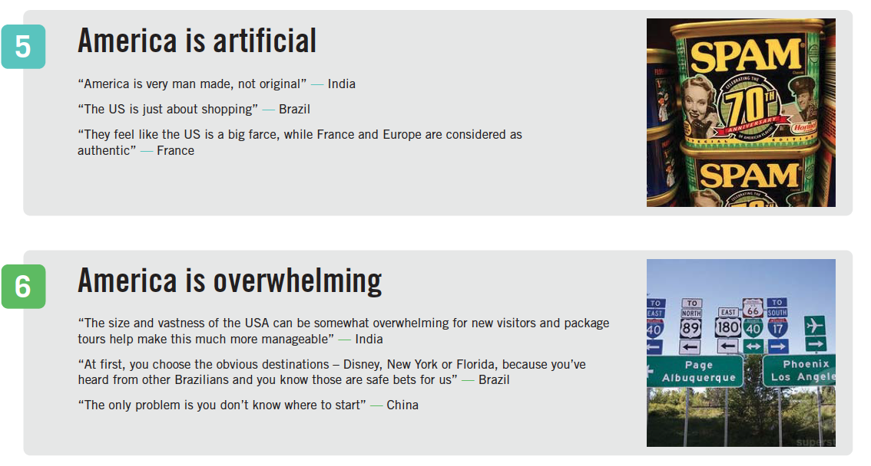
Perceptual Barriers

Slide 11
Barriers Motives
Too Familiar
Middle Aged
Brash + Arrogant
Not Welcoming
Pop Culture
Diversity
Freedom
Possibilities

Slide 12
Uniquely USA
IDEA
DESTINATION
Freedom
“Can Do”
Tolerance
Possibility
Popular Culture
Open & Friendly
Diversity of People & Places

Slide 13
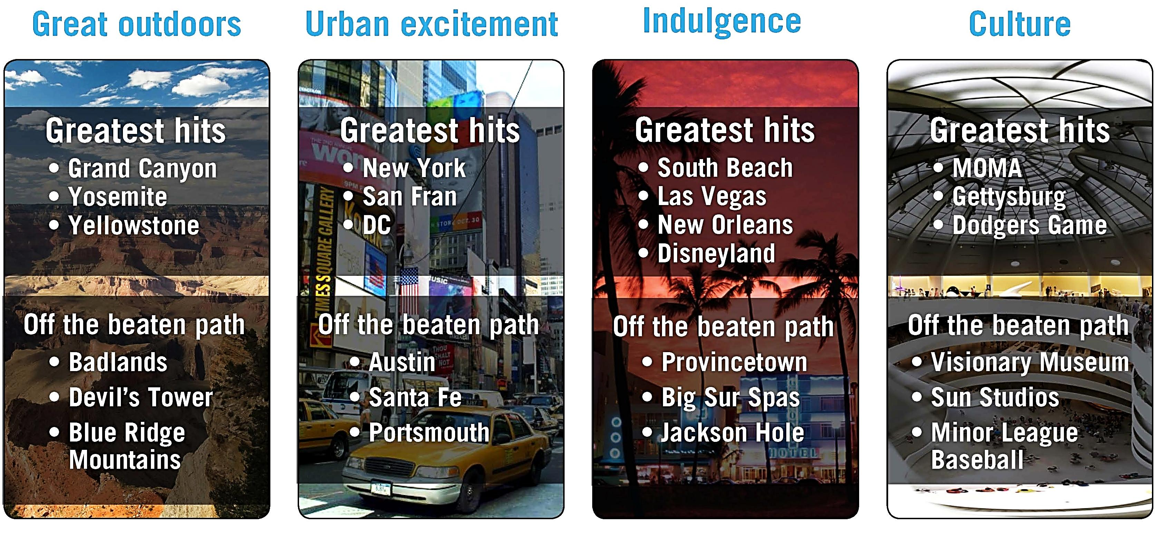
Experience Pillars The USA of Awesome Possibilities

Slide 14
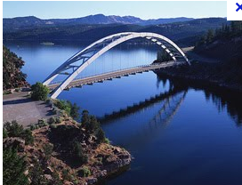
The Solution
Fresh
Unexpected
Welcoming
Awesome Possibilities

Slide 15
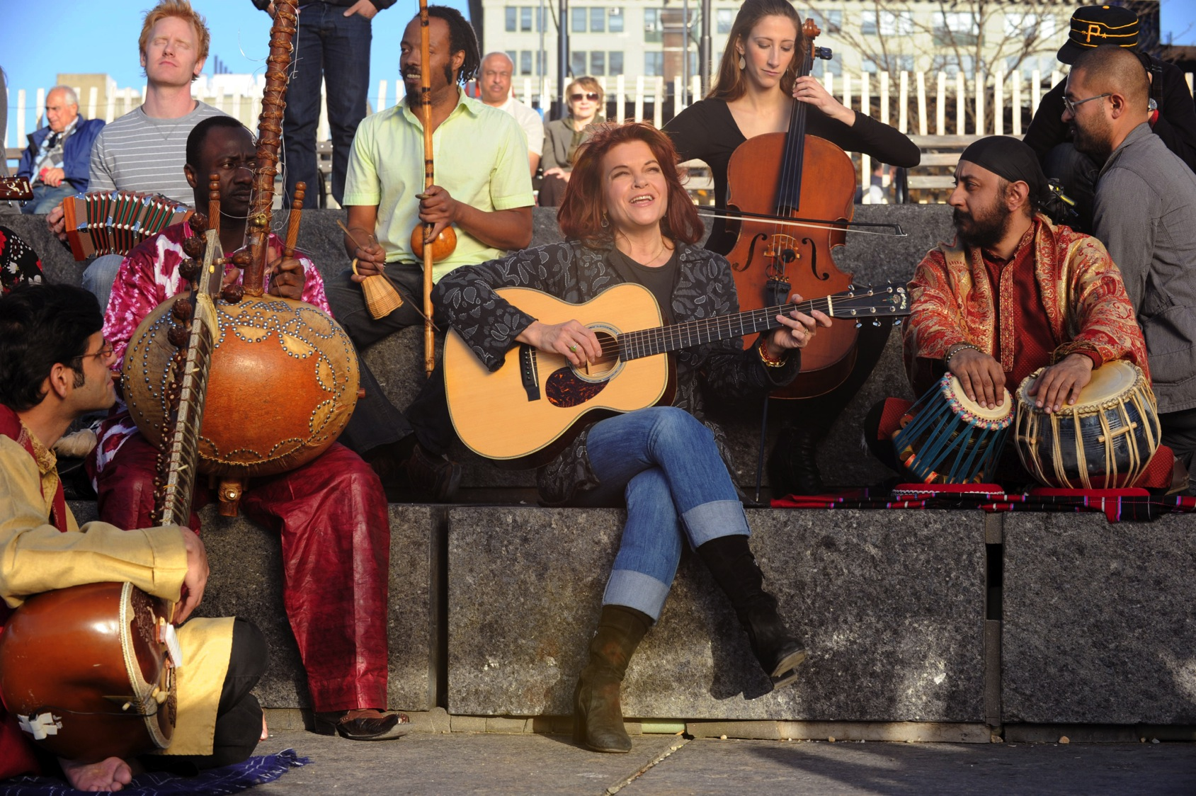
Notes:
So we decided to tell the story not through one voice, but through multiple voices…of artists and musicians from the US and around the world, united in a love of of this country.
Here’s a behind the scenes look at the making of the campaign….

Slide 16
TV
Notes:
----- Meeting Notes (10/2/12 14:29) -----
Next slide is the TV commercial

Slide 17
:60 SPOT VIDEO ROLLS

Slide 18
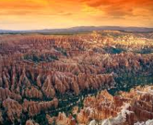
Print

Slide 20
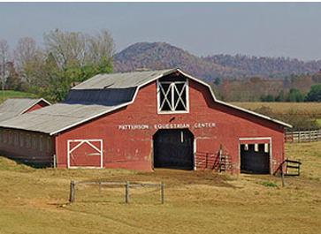
Out Of Home
Billboards and Signage
Transit Advertising
In Cinema / Theater Multimedia

Slide 21
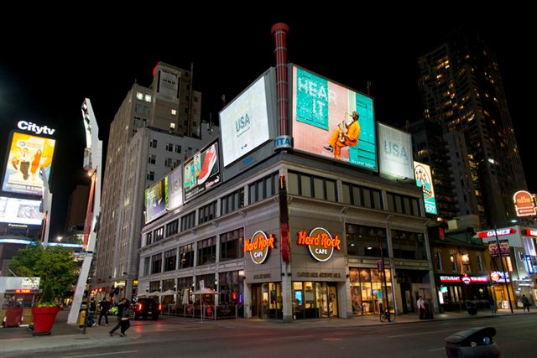
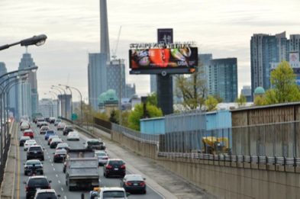
Out of Home in Canada

Slide 22
Digital Advertising

Slide 23
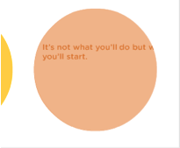
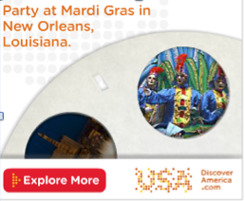
Urban Excitement

Slide 24
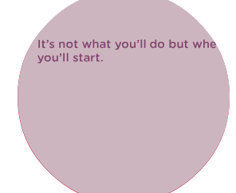
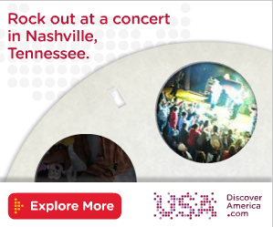
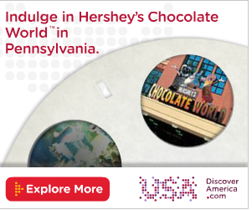
Indulgence

Slide 25
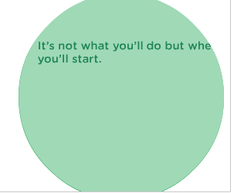
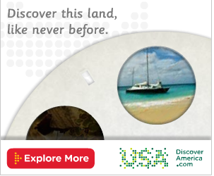
Great Outdoors

Slide 26
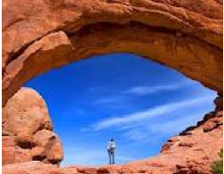
Market Roll Out

Slide 27
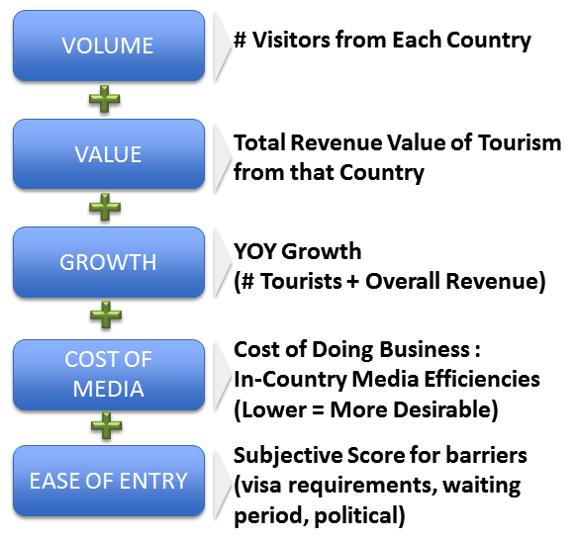
Market Selection Variables

Slide 28
Launch (First 3 Months) May through July 2012
Market | % Visits* | Average Value Per Visitor* | % Revenue | 3-Month Launch Media Budget
Japan | 6.6% | $4,299 | 15% | $2.9MM
UK | 7.5% | $3,003 | 12% | $3.9MM
Canada | 39.0% | $1,043 | 21% | $5.5MM
TOTAL | 52.1% | $2,781.67 | 48% | $12.3MM
*Source: OTTI

Slide 29
Consumer Advertising Market Launches
Launch Markets
Canada
Japan
UK
Future
Markets
Australia
Brazil
South Korea
France
Mexico
China
Germany
Switzerland
Argentina
India
Italy
Spain
Netherlands
Notes:
To be replaced with a map that adds countries we launched, next 6 and then the remaining 7

Slide 30
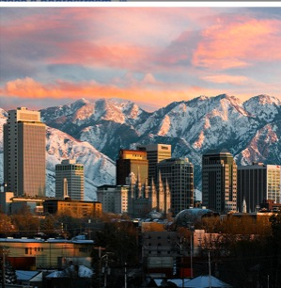
Global Infrastructure

Slide 31
Global Infrastructure
Countries/Regions Representation
Current Representation:
Germany, Switzerland, Austria - BrandMasters
JAPAN –Avia Reps
SOUTH KOREA-Avia Reps
UK / IRELAND – Black Diamond
BRAZIL – Insight Marketing
Upcoming Rep Firms Schedule for Interview:
Australia and Oceania
China
India
Multiple Country Representation
OCEANIA: (Australia, New Zealand)
NORDIC: (Sweden, Denmark, Norway, Finland)
S. AMERICA: (Colombia, Venezuela, Argentina, Ecuador, Peru)
BENELUX: (Netherlands, Belgium, Luxembourg) Additional Individual Countries:
MIDDLE EAST: (GCC/ Egypt/ Mediterranean) Israel
SOUTH AFRICA: (Sub-Saharan Countries) Turkey
EASTERN EUROPE: (Russia, Poland, Czech Republic, Hungary) Mexico
CHINA & HONG KONG India
SPAIN & PORTUGAL France

Slide 32
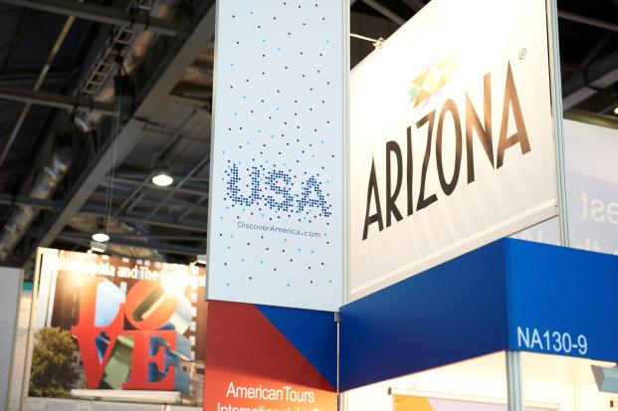
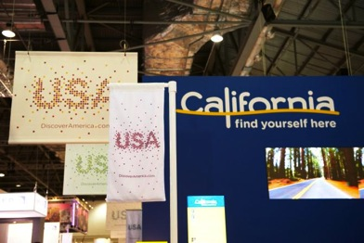
Events & Tradeshows
International trade shows and trade missions are a critical platform in Brand USA’s marketing strategy.
Brand USA will serve as a unifying element for representing U.S. travel and tourism interests globally. Branded USA Pavilions will aggregate featured destinations and amplify our experience pillars.

Slide 33
USA Pavilions FY 2012-2013
DATE | COUNTRY | TRADESHOW
Sept 18-21, 2012 | France | IFTM Top Resa
Sept 20-23, 2012 | Japan | JATA
Oct 3-5, 2012 | Singapore | ITB Asia
Oct 18-20, 2012 | Italy | TTG Incontri
Oct 24-26, 2012 | Brazil | ABAV
Nov 3-6, 2012 | Argentina | FIT
Nov 5-8, 2012 | U.K. | WTM
Nov 15-18, 2012 | China | CITM
Nov 27-29, 2012 | Spain | EIBTM
Jan 16-18, 2013 | New Delhi, India | SATTE
Jan 21-22, 2013 | Mumbai, India | SATTE
Jan 30–Feb 3, 2013 | Spain | FITUR
Feb 13-17, 2013 | Italy | BIT
March 6-10, 2013 | Germany | ITB
Mar 20-23, 2013 | Russia | MITT
Mar 21-24, 2013 | Sweden | TUR
April 23-25, 2013 | Brazil | WTM Latin America
May 6 - 9, 2013 | UAE | ATM
May 21 – 23, 2013 | Germany | IMEX
June 8-12, 2013 | Las Vegas, USA | Pow Wow
June 21 - 23, 2013 | China | BITE

Slide 34
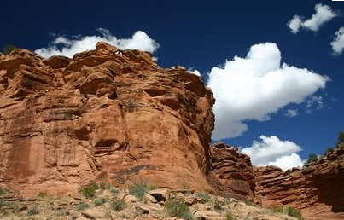
Metrics and Analytics Dashboard

Slide 35
Research & Metrics Goals
Demonstrate campaign performance/ROI and optimize media and creative
Listen to social conversations to uncover sentiment, opportunities and measure impact
Create best-ever international travel and tourism insights with actionable information for partners Develop a standardized best-practices ROI methodology for Partners, particularly DMOs

Slide 36
How We Track Success
Awareness
Education
Consideration
Advocacy
Unaided vacation destination awareness
Campaign awareness
Campaign response (ad appeal & persuasion)
Familiarity with the USA as a vacation destination
Personality traits
Imagery as a vacation destination
Consideration of USA as a vacation destination
Type of vacation considering in the USA
How soon they plan to travel to the USA
Planned length of stay in the USA
Number of destinations planned
Positive recommendations of the USA as a travel destination
Actions taken as a result of exposure to ‘Land of Dreams’
Note: Metrics highlighted in red = “Indicators of action”

Slide 37
Quantitative Research
Pre-wave Benchmark Completed
Prior to launch in all launch markets
Post-Launch Wave 1 Measurement Report – Sept 6
UK topline July 13
Japan topline July 20
Canada topline August 17
Ongoing Data Aggregation & Analysis
OTTI
Amadeus
Oxford Economics
More...

Slide 38
Campaign Metrics
Consumer Journey
Awareness & Perception | Consideration & Investigation | Action (Book/ Trip) | Travel Behavior & Activities | Advocacy & Ambassadorship
Awareness of the USA’s tourism outreach efforts overall and by channel | Website and digital paid advertising clicks and downloads by medium and creative | Book & take trip as a percent of consideration by channel and creative connecting behavior to advertising plan | Comparison of messaging vs trip behavior to optimize mix Example: % of visits are “culture-focused” vs % of campaign messaging | Response to brand ambassador communication by medium and creative

Slide 39
Campaign Driving Intended Results First 3 Months
vs Pre Launch
+21 pts
BRAND USA IMAGE ATTRIBUTES (UK)
The USA as a destination
on its way up
AFTER
BEFORE
67%
59%
Japan
Intention to visit is on the rise in campaign markets
51%
57%
United Kingdom
Source: Hall & Partners Pre- and Post-Wave Campaign Tracker (Japan & UK)

Slide 40
Campaign Driving Intended Results First 3 Months
Social Media Sentiment
99%
16k song downloads
DiscoverAmerica.com Page Views
Facebook Fans and Followers
79k
3 mm

Slide 41
Campaign Driving Intended Results First 3 Months
Image Attributes (USA)
Post vs. Pre Launch
“A place you always feels welcome”
+5 pts
Japan
“A place with limitless possibilities”
+10 pts
UK
“Has something for everyone”
+8 pts
UK
“Adventurous”
+11 pts
Japan
“Energetic”
+8 pts
UK
“Optimistic”
+11 pts
UK
Source: Hall & Partners Pre- and Post-Wave Campaign Tracker (Japan & UK)

Slide 42
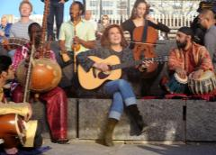
Campaign Results: Canada
CANADA
Campaign Reach and Awareness Among Affluent Travelers
58%
Recognized at least one element of the campaign (TV, Print, Out of Home, or Digital)
47%
Recognized and linked “Land of Dreams” to the United States

Slide 43
Campaign Results: Japan
JAPAN
Campaign Reach and Awareness Among Affluent Travelers
30%
Recognized at least one element of the campaign (TV, Print, Out of Home, or Digital)
24%
Recognized and linked “Land of Dreams” to the United States

Slide 44
Campaign Results: United Kingdom
UNITED KINGDOM
Campaign Reach and Awareness Among Affluent Travelers
28%
Recognized at least one element of the campaign (TV, Print, Out of Home, or Digital)
19%
Recognized and linked “Land of Dreams” to the United States

Slide 45
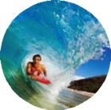
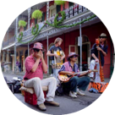
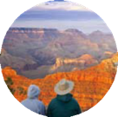
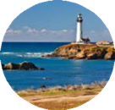
Benefit from the Exponential Power of the USA’s Global Campaign
5 Ways to Partner
 | CONTRIBUTE | Benefit from the exponential power of our global campaign with a direct cash investment
 | CONNECT | Connect with the industry’s largest representation network—(trade shows, sales missions, mega fams, visiting journalist programs, PR, and more)
 | CO-OP | Participate in co-op marketing and advertising campaigns with Brand USA (social media, print, broadcast, out-of-home, joint media buys, visitor guides, co-op media partnerships, and more)
 | CO-MARKET | Promote Brand USA in your marketing programs, on your website, in your target marketing
 | COLLABORATE | Collaborate with us on research initiatives or create other customized programs

Slide 46
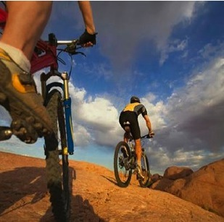
Partnership Opportunities
Co-op Advertising
Brand USA Led
Partner Led
Joint Media Planning and Buying
Publisher Co-ops
Turn-key Media Co-op
Official Inspirational Guide
Digital
DiscoverAmerica.com
Trip Tuner
Native Content Creation Social Media
Other Opportunities
Fam Tours
International Representation Network Trade Shows and Sales Missions
Research

Slide 47
Social Media Opportunities

Slide 48
Social Media Learnings via Facebook
UK | JAPAN | CANADA
Audience is well-engaged, about 0.5-0.8% of audience per post Audience is well-traveled in the US, enthusiastic about sharing personal experiences American pop culture is very relevant Scenic, fair weather-related content that contrasts with the bad weather in the UK Strong, positive reaction to national parks, nature, and city photography Dramatic, unusual scenery is also popular in the UK | Audience is very highly engaged, 5% of total audience per post Fans are well-traveled in the US, love to talk about their personal experiences in a sentimental way Use messages that relate back to current events in local market have shown to be successful Shows strong affinity for quirky, "cutesy" images Enjoys California & Hawaii, architecture, pop culture and scenic content | Photo and trivia/question content is effective, they are more familiar with the US Interactions in French Canada market have been particularly strong with these of posts Relating messages back to local market events/history, topical, timely messages resonate This market has the strongest affiliation and identification with messages that relate back to campaign assets like the "Land of Dreams" video Food and outdoors/beach photo albums showcasing the diversity and uniqueness of US were popular There was a particularly strong interest in beaches NYC/New England content seems to be more popular with the French Canadian Having a dedicated, French language Community Manager has been invaluable to this market

Slide 49
Social Learnings via Twitter
UK | JAPAN | CANADA
Engagements with influencer/blogger accounts have shown success Messages about quirky, unusual events see high engagements Relating local events with US events have proven effective People enjoy sharing personal travel stories | Trivia, interesting and unknown facts generate a high level of interaction Visual assets also see a high rate of engagement Scenic photos are seen as more sharable on Twitter | Participation in group Twitter chats and strong involvement in the travel community Twitter has been a strong platform for the brand's growth in the Canadian market Having a separate French Canada Twitter account has been key Promoting fun facts/trivia, useful travel information and more directional seasonal guide is popular

Slide 50
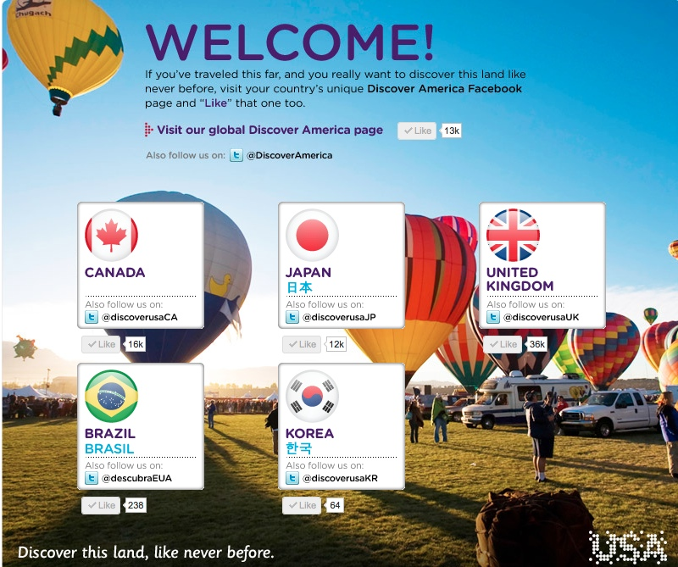
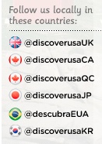
Social Opportunities
Build communities within our targeted countries on social channels and in language
Engage audience in their native environment
Create authenticity
Identify influencers

Slide 51
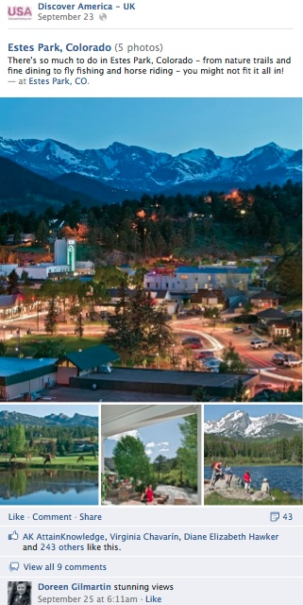
Social Opportunities:
Photo Gallery
Supplying photos for a photo gallery on our global pages.
Timeline Cover
These photos change weekly across our global Facebook pages.
Story / Experience Content
Storytelling can be incorporated as a part of integrated partnership and added to paid features in social channels and within DA.com.
Let’s Connect ---Extend Content
Submit Internationally focused social accounts for DiscoverAmerica to “like” you on our language pages.
URL submission
Submit your International URLs for
your International websites.

Slide 52
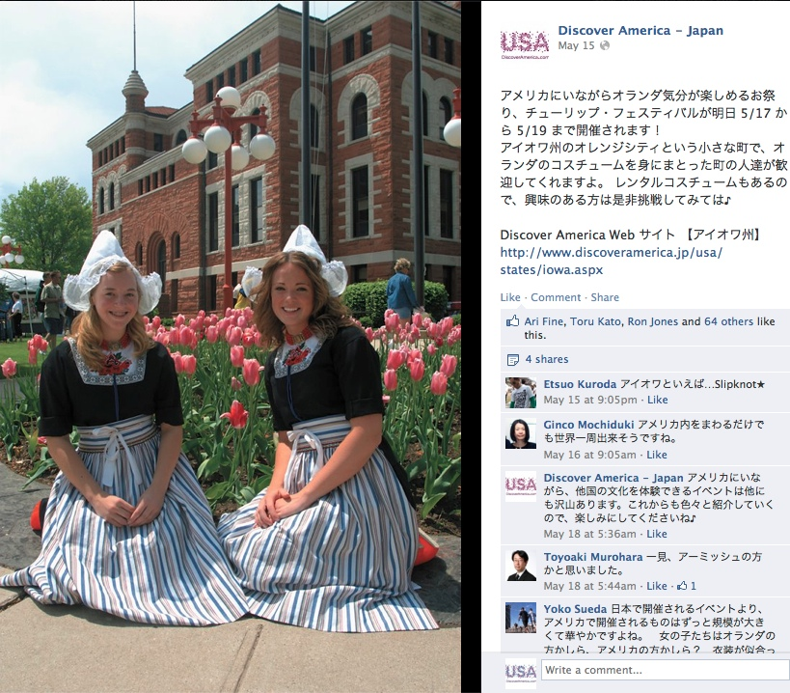
Social Opportunities: In-Kind Contribution
Supply photos, events, video and news to populate the themed global calendar based on a variety of categories.
khanson@thebrandusa.com

Slide 53
Social Opportunities
Notes:
----- Meeting Notes (10/18/12 15:07) -----
These are two of my favorite photos in the entire presentation. Frank posted this photo on our UK page showing how Superman is a global phenom. Is Sandra from Niland's Cafe and Colo Motel here today?

Slide 54
Social Opportunities

Slide 55
Website

Slide 56
In-Kind Logo Inclusion
Brand USA & Partner review in-kind categories and identify opportunities:
Logo Inclusion
Add the Brand USA logo to any of your marketing materials
Digital Assets
Website, social, email
Advertising
TV, print, OOH, digital, banner, radio
Collateral Material
brochures, guides, direct mail

Slide 57
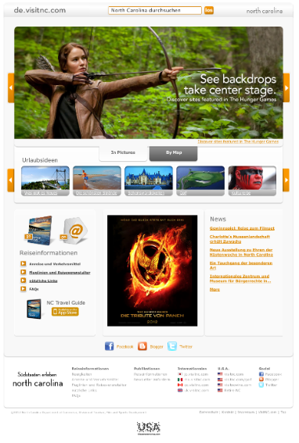
Website with Logo Example

Slide 58
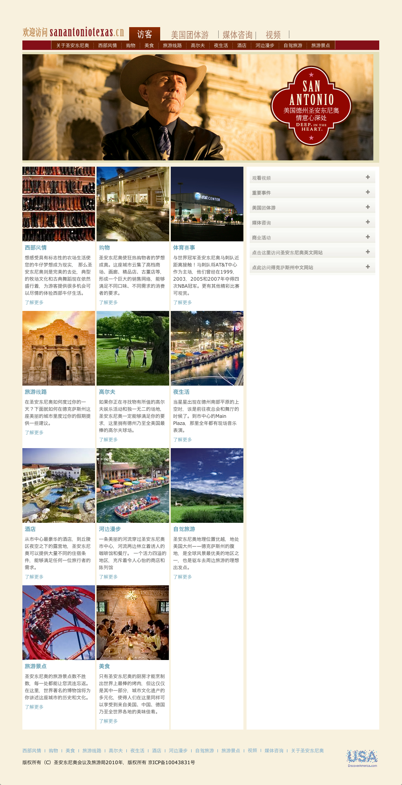
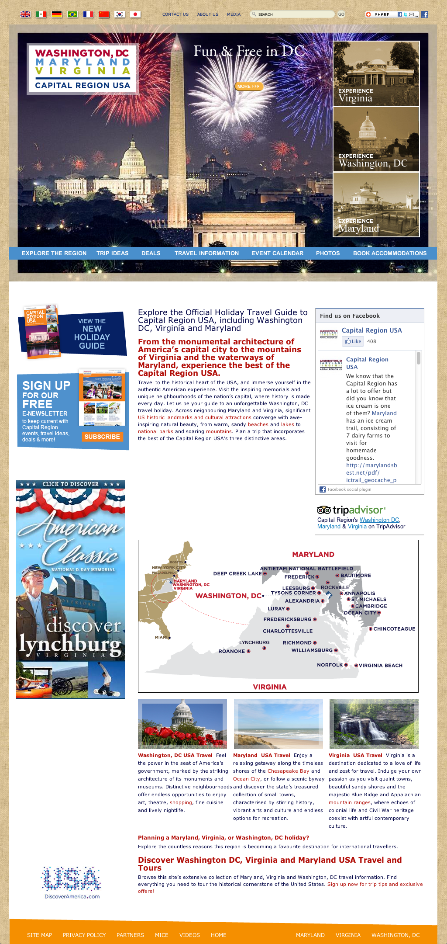
Website with Logo Example

Slide 59
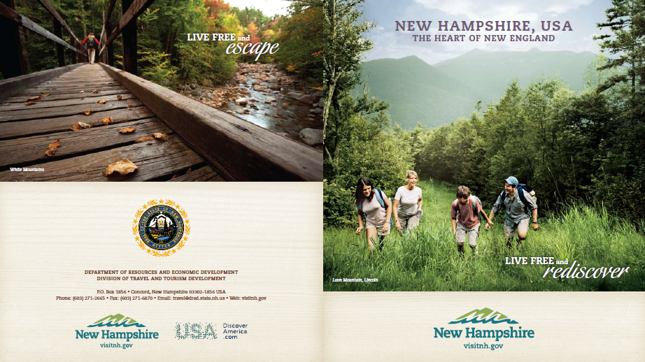
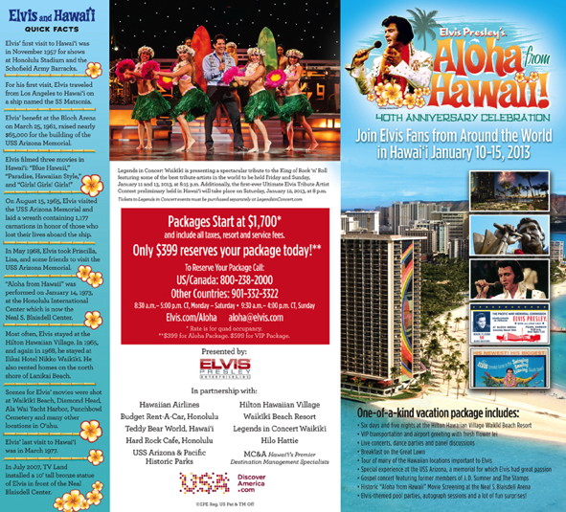
Brochure with Logo Example

Slide 60
In-Kind Research
Brand USA & Partner review in-kind categories and identify opportunities:
Research
Partners can donate proprietary research done for support of international marketing or targeting efforts
Examples:
Tracking
Messaging
Trip planning behavior
Trip booking behavior

Slide 61
Fully Managed Coops

Slide 62
Fully Managed Coop

Slide 63
Fully Managed Coop

Slide 64
Thank You
Travel Industry Information
@BrandUSA on Twitter
TheBrandUSA.com
Consumer Information
@DiscoverAmerica on Twitter
Facebook.com/DiscoverAmerica
DiscoverAmerica.com

