Slide 1
Ebola and Rhode Island:
Calm, Thoughtful, Vigilant
Michael Fine, MD
Rhode Island Department of Health
Last updated: December 16, 2014
Notes:
*

Slide 2
An evolving process
Healthcare workers, CDC, and others are learning how best to respond
We are expanding response to meet the needs
There will be changes and adjustments
Notes:
*

Slide 3
Overview
2014 West Africa Ebola outbreak is the worst in history
Case fatality rate in Liberia, Guinea, and Sierra Leone 50-70% (20% in US)
Only people who have been in Liberia, Guinea, Sierra Leone, and Mali in prior 21 days are at risk
People are not contagious until they show symptoms
No vaccine or treatment besides supportive care
While we may see a few imported cases in RI, good public health collaboration will likely prevent any spread
Notes:
US case fatality rate: 2/10 = 0.20. This number includes all cases of Ebola treated in the US.
Case fatality rate in Liberia, Guinea, and Sierra Leone in hospitalized patients is 61%.
Last updated 12/10/14
*

Slide 4
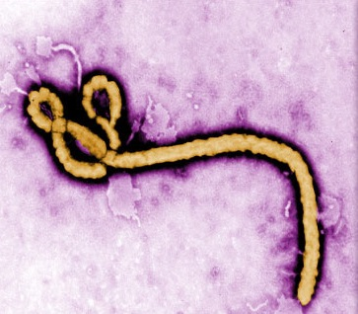
Ebola Virus Disease
Filovirus
A severe, often fatal disease in humans and animals (bats, monkeys, gorillas, and chimpanzees in Africa)
Notes:
Source: HEALTH WEBSITE, http://health.ri.gov/diseases/viralhemorrhagicfever/?parm=139
*

Slide 5
Ebola Virus Ecology
People get Ebola from bats or other animals by handling infected meat or fruit exposed to body fluids of animals.
People can transmit Ebola to each other.
Notes:
*

Slide 6
How Ebola Spreads
The virus is spread through body fluids.
A person becomes infected by touching or handling:
A person who is sick with Ebola (and symptomatic)
Objects contaminated with body fluids
The body of a deceased Ebola victim
The virus enters the body through:
Hand to mouth contact
Hand to eye, nose, mouth contact
An open cut, wound, abrasion (incl. needle sticks)
Sexual contact
Body Fluids:
Blood
Vomit
Feces
Urine
Saliva
Breast milk
Sweat
Semen
Notes:
Source: http://www.cdc.gov/vhf/ebola/transmission/index.html
*

Slide 7
Ebola is NOT Spread by:
Air
Water
Food (except bush meat)
Mosquitoes
People without Ebola symptoms
Notes:
*

Slide 8
Life of Ebola Virus
Ebola lives in wet body fluids outside the body for several days.
The virus lives on a dry surface for several hours.
The virus lives in the body of a deceased patient for weeks.
Evidence of Ebola virus is detectable in the semen of people who have recovered for 2-3 months.
Notes:
*

Slide 9
Transmission Scenarios
A hunter or cook handles, cleans, or eats meat from an infected animal from West Africa.
A family member or caregiver cleans up after a sick Ebola patient and removes their soiled sheets to do laundry, without wearing PPE.
At a funeral in West Africa, many mourners unknowingly touch a loved one who died from Ebola, wipe tears, cover their mouths, rub their eyes, etc.
A healthcare worker treats an Ebola patient without wearing Personal Protective Equipment (PPE), or improperly reuses PPE, or removes PPE in the wrong order.
Notes:
*

Slide 10
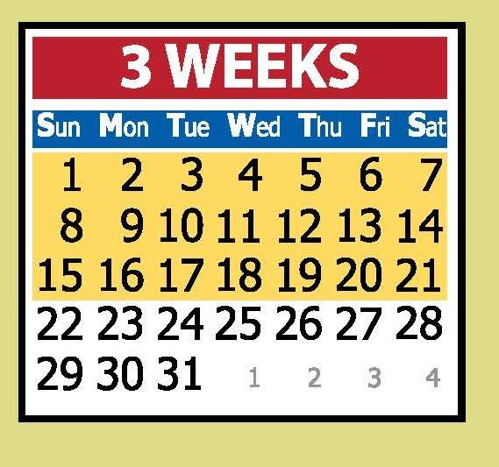
Ebola: Symptoms
Symptoms usually begin 2 to 21 days after exposure:
Fever
Severe headache
Muscle pain
Weakness
Diarrhea
Vomiting
Abdominal pain
Lack of appetite
Unexplained bleeding or bruising
(very similar to symptoms of the flu)
If you aren’t sick after 21 days since exposure, you will not become sick with Ebola.
If you haven’t been to Liberia, Guinea, Sierra Leone, or Mali in the last 21 days, you do not have Ebola.
Notes:
*

Slide 11
How Ebola is Treated
No vaccine yet
No proven treatment yet--care is supportive (fluids, oxygen, etc.)
Ebola transmission can be stopped by classic public health management:
contact tracing
identification of all cases
isolation
Notes:
*

Slide 12
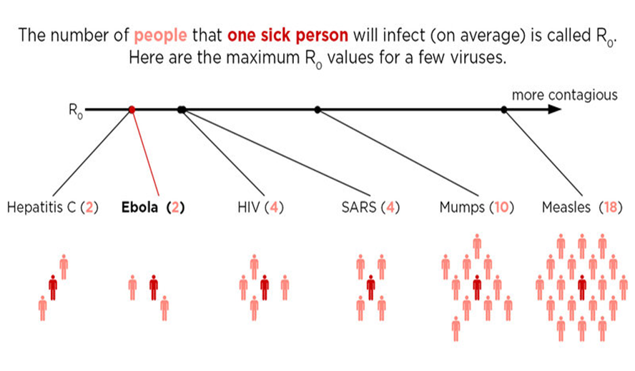
Comparison of Contagiousness
Notes:
*

Slide 13
Risks to Healthcare Workers
Health workers treating patients with suspected/confirmed illness at higher risk of infection
People are not contagious until they have symptoms
Overwhelmingly viremic when symptomatic
General public is generally safe
Notes:
Highest risk groups may come in contact with the blood or body fluids of sick patients. A wet Ebola patient is one who is advanced in illness status and is producing copious body fluids (vomiting/diarrhea) and poses a high risk of transmission to caregivers.
A dry Ebola patient is early in disease evolution and presents less risk of transmission to contacts and caregivers as there is less infected body fluid exiting the patient.
*

Slide 14
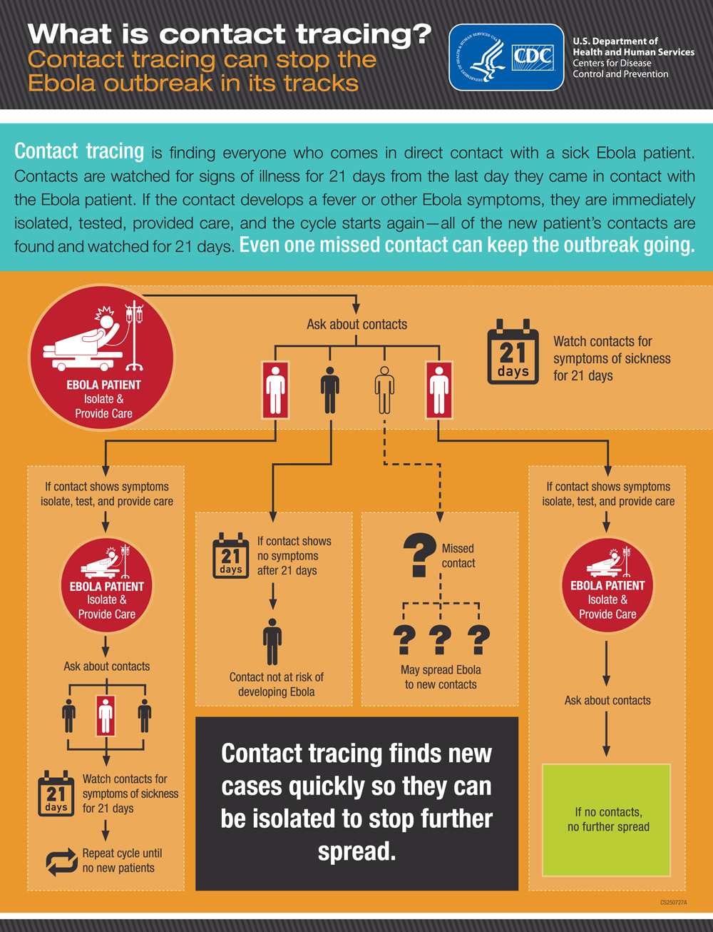
How is an Outbreak Stopped?
Find:
Find and diagnose patients.
Respond:
Isolate patients, find and monitor patient contacts.
Prevent:
Healthcare infection control, avoid risk factors.
Notes:
Find everyone who comes in direct contact with a sick Ebola patient and evaluate exposure
Those exposed are monitored twice a day for temperature and watched for symptoms for 21 days from exposure
If fever or other symptoms develop, contact is immediately isolated, tested, and given care
Cycle starts again with new patient’s contacts
*

Slide 15
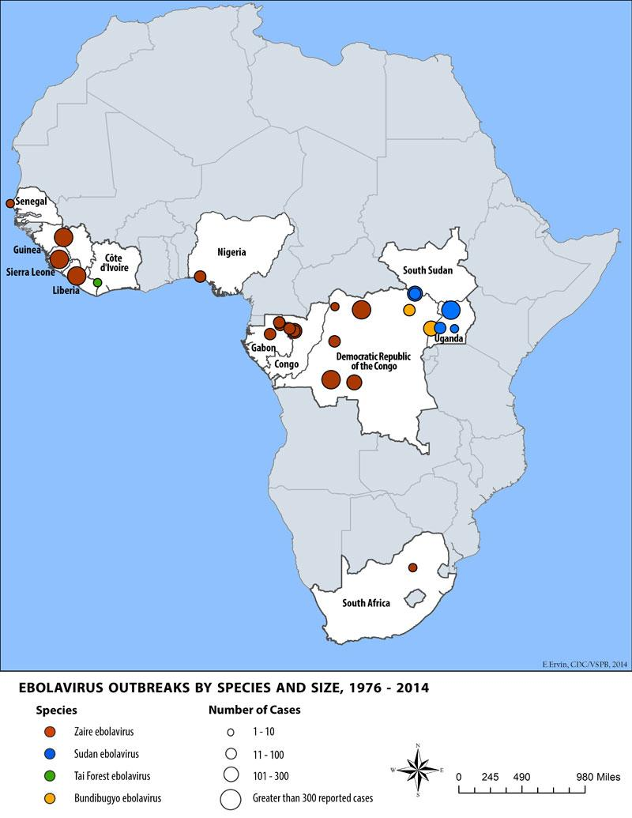
Ebola Outbreaks In Africa 1976 - 2014
First outbreak: 1976 in Zaire (now Democratic Republic of the Congo)
Spread by close personal contact and use of contaminated needles and syringes in hospitals and clinics
Ten other outbreaks of the Zaire ebolavirus since 1976 with a range of 2 to 315 people infected per outbreak and fatality rates of 57% to 89%
Notes:
http://www.cdc.gov/vhf/ebola/outbreaks/history/distribution-map.html
Note: data in last bullet are combined from 10 outbreaks.
*

Slide 16
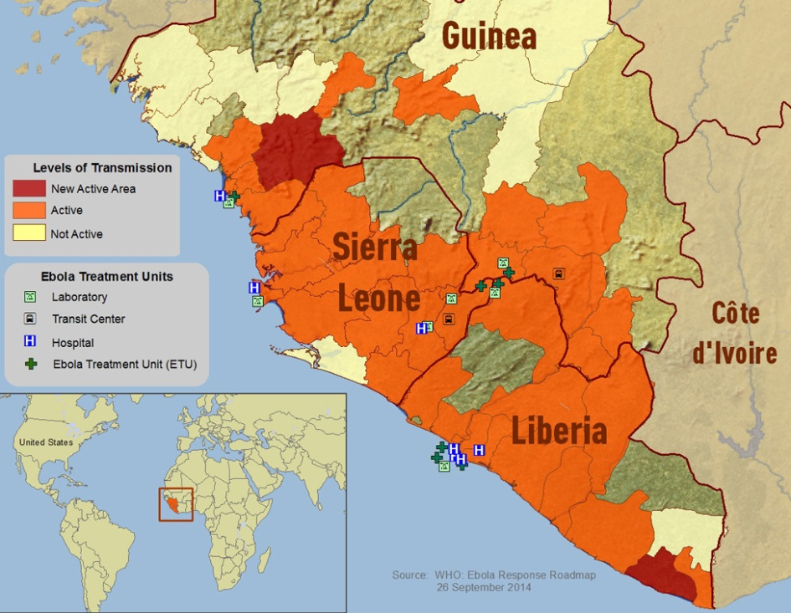
2014 West Africa Outbreak
Largest, deadliest Ebola outbreak in history
First in West Africa
Seven countries have been affected:
Outbreak control now focused primarily in Guinea, Liberia, and Sierra Leone.
WHO officially declared Senegal, Nigeria, and Spain free of Ebola virus transmission.
8 cases in Mali
3 cases in Dallas, Texas
1 case in New York City
Notes:
* Case counts and deaths are as of Nov 19, 2014. Sources: http://www.who.int/csr/disease/ebola/situation-reports/en/ and http://www.cdc.gov/vhf/ebola/outbreaks/2014-west-africa/index.html
*

Slide 17
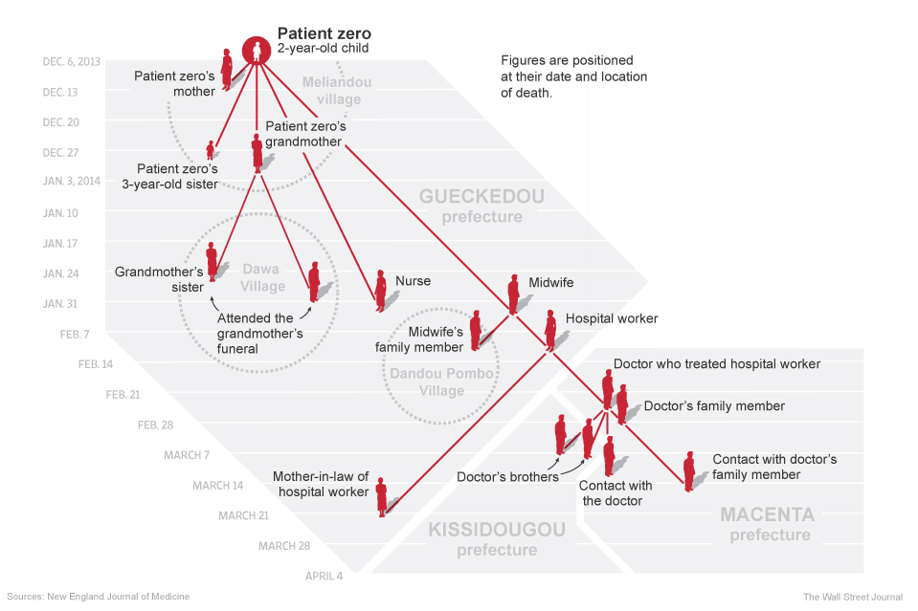
How the 2014 West Africa Outbreak Began
Notes:
Source: http://graphics.wsj.com/ebola-crisis/
*

Slide 18
Current Situation
As of December 17:
6915 reported deaths
18,603 reported cases
CDC initially estimated underreporting by rate of 2.5; new estimates suggest underreporting occurs at a rate of 1.2
Notes:
Source: http://www.who.int/csr/disease/ebola/situation-reports/en/
* Estimates have varied.
*

Slide 19
US Cases
As of Dec 18, 2014, ten Ebola patients treated in US hospitals:
Four cases diagnosed domestically
Three in Dallas, TX
One in New York City
Six cases acquired internationally and medically evacuated to US
Notes:
*As of 12/16/14. Source: http://www.cdc.gov/vhf/ebola/outbreaks/2014-west-africa/index.html and media reports.
*

Slide 20
Travelers from Liberia, Guinea, Sierra Leone, and Mali
We are in daily contact with every person in Rhode Island we know to be at risk for Ebola.
Very unlikely that a person with Ebola symptoms would be encountered anywhere other than at a hospital or through EMS
Notes:
*

Slide 22
Active Monitoring of Low-Risk Travelers Returning from Ebola
Affected Countries to Rhode Island*, as of December 15, 2014
 | Number
Low-Risk Travelers Reported | 40
Transferred to Another Jurisdiction Before Active Monitoring Initiated in Rhode Island | 2
Transferred to Another Jurisdiction After Active Monitoring Initiated in Rhode Island | 1
Completed Active Monitoring | 25
Currently Under Active Monitoring | 12
Of those currently under Active Monitoring:
Will complete by December 21 | 2
Will complete by December 28 | 7
Will complete by January 4 | 3
* Rhode Island began receiving reports of travelers from the CDC on October 17, 2014.
Created by the Division of Infectious Disease Epidemiology, December 15, 2014

Slide 23
Public Health Response Controls the Spread of Ebola
Nigeria was successful in stopping spread, with 20 cases and contact tracing of 900 people exposed.
Declared Ebola free by WHO
Notes:
*

Slide 24
HEALTH Ebola Preparedness and Response Strategies
Communication with healthcare facilities and professionals
Health Information Center
Speakers Bureau
Regular conference calls
Provider and partner briefings
Consultation
Close collaboration with West African community
Careful coordination with CDC
Incident Command System activated on 10/14
Collaborative planning with other state agencies
Implementing CDC recommendations for Monitoring and Movement
Notes:
*

Slide 25
Joint Planning
Collaborative effort between RIEMA, HEALTH, other state agencies
Expanding response to deal with evolving knowledge and expertise and changing recommendations
Rhode Island Ebola Response Plan
Outlines activities of each state agency with major role in responding to an Ebola case
Annex to State Emergency Operations Plan
Lays out role and response to:
Likely positive case
True positive case
More than one case
Completed and approved on 10/23
Notes:
*

Slide 26
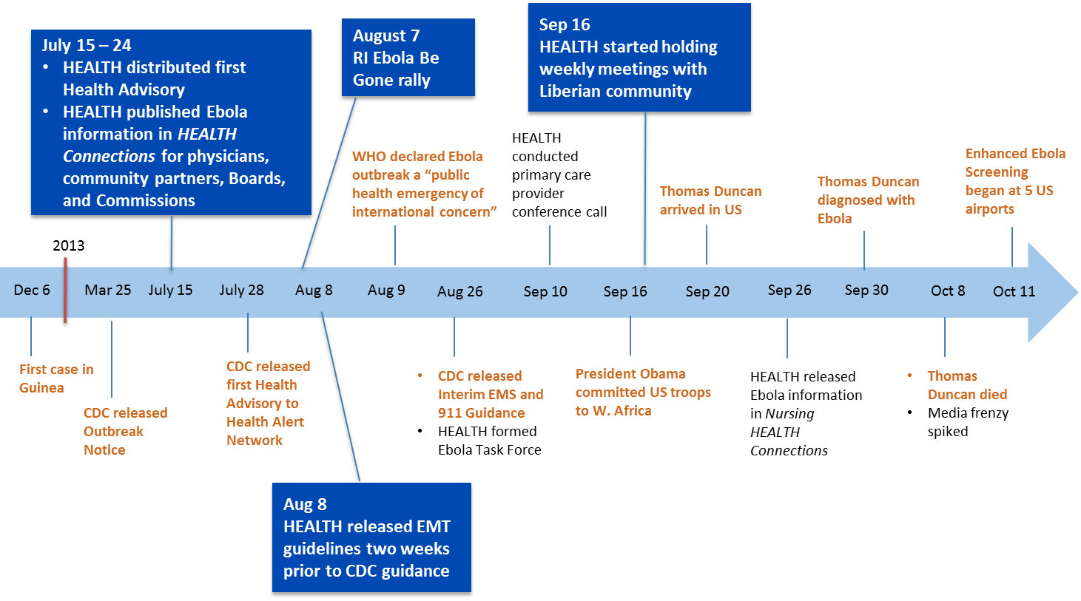
Rhode Island Department of Health Ebola Response Timeline

Slide 27
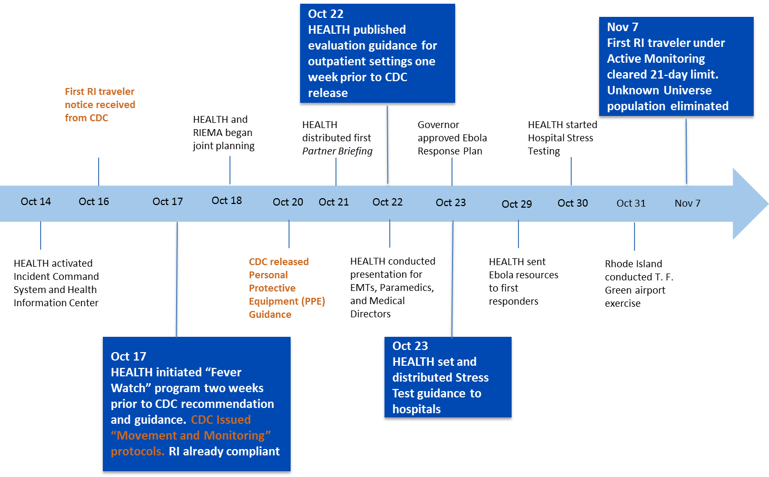
Rhode Island Department of Health Ebola Response Timeline

Slide 28
Consultation and Guidance Provided to...
Physicians
Nurses
Physician assistants
Emergency medical technicians
Emergency medical services
First responders
Oral health professionals
Mental health professionals
Pharmacists
Infection control practitioners
Clinical laboratories
Health centers
Hospitals
Long-term care and assisted living facilities
Urgent care centers
Schools and colleges
Funeral directors
State employees
State government leaders
Liberian community
Volunteers
Coast guard
Boards and commissions
Community partners
Notes:
*

Slide 29
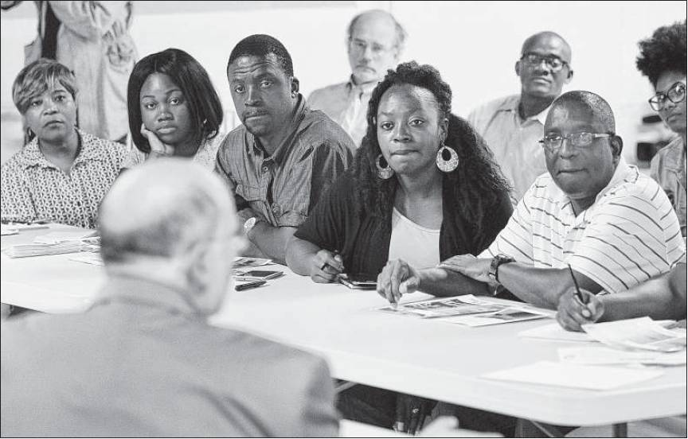
HEALTH’s Collaboration with RI’s West African Community
Nearly 15,000 with ties to West Africa
Began weekly meetings on September 16
Collaboration with community elders and youth
Activities:
Statehouse Rally, August 2014
Ebola Be Gone Call 5 campaign with United Way & Cox Communications
Weekly meetings
Church and other community meetings
Flyer distribution
Supplies drive
Three relief funds
Candlelight vigil
Notes:
*

Slide 30
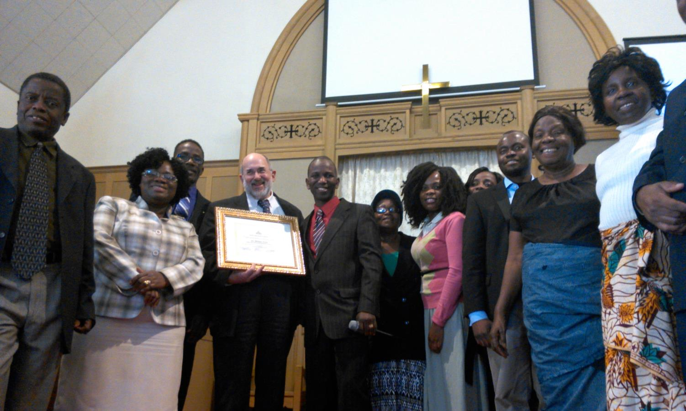
HEALTH’s Collaboration with RI’s West African Community
Notes:
*

Slide 31
Hospital Stress Testing
Notes:
31

Slide 32
Hospital Stress Testing
Collaborative training exercise with each hospital
Met with Hospital CEOs in advance and received voluntary consent to participate
Notes:
*

Slide 33
Four-step process
Request for inventory and documentation of processes and planning
Documentation review
Full-scale exercise
Comprehensive feedback consultation with staff
Notes:
*

Slide 34
HEALTH exercise team training
Included time with:
The ICU physician father of an Ebola patient, who was in regular communication with the University of Nebraska hospital where his son was treated
A physician who volunteered in an Ebola treatment unit in Liberia
Notes:
*

Slide 35
Onsite stress tests
Structured and implemented by HEALTH for all 11 acute-care hospitals with emergency departments, Women and Infants Hospital, and the VA
Subject matter experts from HEALTH served as boots on the ground during tests
Notes:
*

Slide 36
Onsite stress tests
Two programmed patients and team of seven tested every aspect of a hospital’s response
Hired medical actors from Brown Medical School
Scenario varied for each hospital
Evaluated entire process, from Emergency Department entry through proper handling of body after death, including patient transitions
Notes:
*

Slide 37
Onsite stress tests
Completed tests with all Rhode Island acute-care hospitals
Went very well
Good understanding of strengths and areas for improvement
Reviewing results for each hospital and will follow up with hospital leadership this month to review findings
Unannounced follow-up tests will start in early 2015 and depend on findings of initial tests
Notes:
*

Slide 38
Collaborative outpatient drills
Reaching out to select number of outpatient settings in communities with largest number of travelers
Drills would test readiness to detect and manage a person under investigation for Ebola
Very unlikely that a person with Ebola would be encountered anywhere other than through EMS or in a hospital
Notes:
*

Slide 39
Summary
Only people who have been in Liberia, Guinea, Sierra Leone, or Mali in prior 21 days are at risk
We know about every traveler in RI arriving from Liberia, Sierra Leone, Guinea, and Mali and conduct active daily monitoring for Ebola symptoms for these travelers for 21 days.
People are not contagious until they show symptoms
The outbreak can be stopped by good public health practice
While we may see a few imported cases in RI, good public health collaboration will likely prevent any spread
Notes:
*

Slide 40
Michael Fine, MD
Director of Health
www.health.ri.gov
Notes:
*

