Slide 1
Customer Service Keys to Increase Your Business
Blackstone Valley Tourism Business Network
May 5, 2015
Michael Sabitoni, CHE

Slide 2
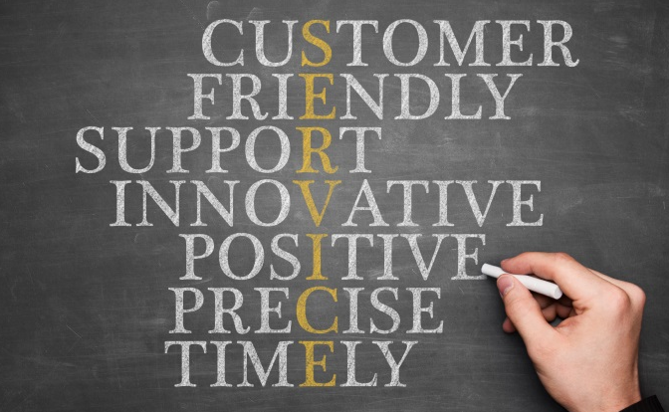
Quality Customer Service
What is Quality Customer Service?
Definition: Quality customer service is consistently surpassing customer expectations in selected areas.
Reminder – Reality is the way guests/patients/families see things. Their perceptions, not your perceptions, influence their behavior. It’s not enough to provide what you think is good service; they have to perceive it as good. If they aren’t satisfied, for whatever reason, it isn’t good service.

Slide 3
Positive and Negative Service Characteristics
Positive Service Characteristics Negative Service Characteristics
Product/service knowledge
Courtesy/politeness
Perceiving customer requirements
Clear speech
Efficiency/promptness
Punctuality
Effective communication
Tolerance to pressure
Assertiveness
Understanding cultural differences
Interest
Ignoring customers
Treating customers as interruptions
Avoiding responsibility, problems, controversy, and issues
Doing work over rather than doing it right the first time
Rudeness
Remember the old adage, “The customer is always right.” This doesn’t mean you have to “give away the store”, but it does mean you must find ways to match customer expectations and company requirements.

Slide 4
Who is Your Customer?
What kind of contact do you have with your external customers?
Who are your internal customers?

Slide 5
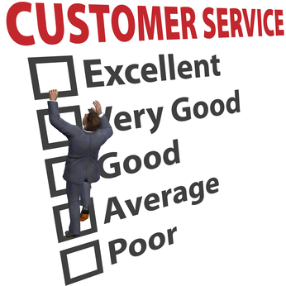
Benefits of Good Service
Quality customer service:
Saves time
Provides recognition and esteem
Creates fewer complaints and less stress
Makes work easier and more enjoyable
Promotes career success and earning potential
Keeps customers

Slide 6
Types of Customer Service
Types of Service
Help me
Fix it
Value-added
What type of service does your area deliver?

Slide 7
Moments of Truth
Every time a customer comes into contact with a company representative, it is a moment of truth. If you refer back to the number of people employed by the company, it is easy to see why service is made up of countless moments of truth each year. Any of those moments provides the opportunity to deliver value-added service.
Step Value-Adding Idea Benefit to: Customer, Company, You

Slide 8
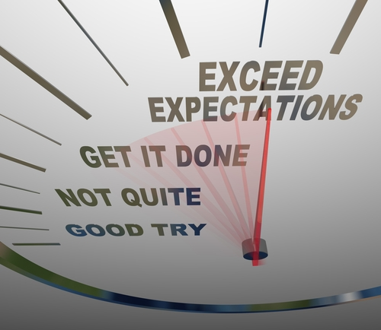
Five Steps to Quality Customer Service
Preparation – Be knowledgeable about the mission, goals, services, products, and procedures of your company and the industry.
Professionalism – Present a credible image, and build a credible reputation through verbal and nonverbal communication. Take the initiative and inspire confidence. Make a good first impression.
Listening Techniques – Deal with the customer’s/patient’s feelings first, showing a regard for his/her needs and an interest in his/her satisfaction.
Provide Information – Answer questions or offer solutions. Provide positive input.
Add Value – Provide those extras that are more than what the customer/patient expects. Do things right 100 percent of the time.

Slide 9
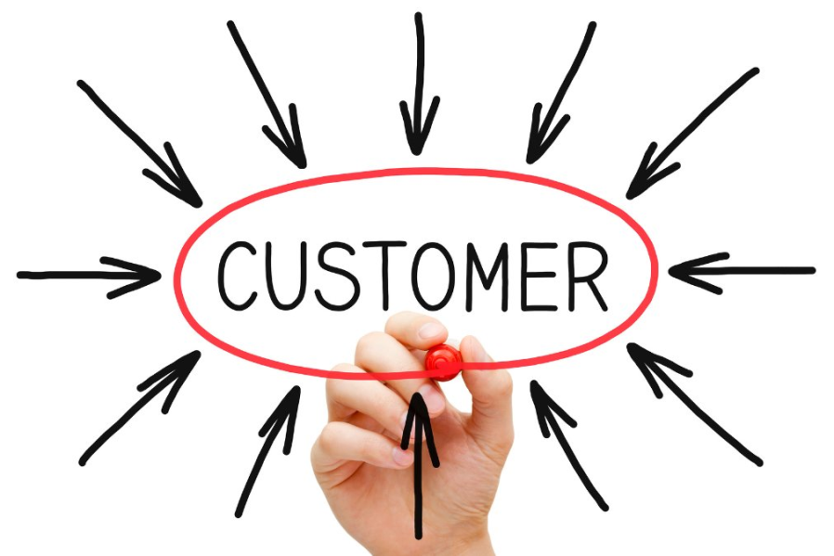
The central idea for a business to keep in mind when designing a customer experience or executing customer service is that your customer’s relationships with each other are central to action. The relationship that matters is among your customers; the relationship between your customer and their service provider—you—is in a real sense secondary. It’s a role for you of facilitation and support. If you provide a stage, a backdrop for the primary relationships of your customer, you can become, and remain, their provider of choice.
http://www.forbes.com/sites/micahsolomon/2014/10/14/customer-service-beyond-coupling-from-hospitality-four-seasons-to-healthcare-mayo-clinic/

Slide 10
“Hire friendly, train technical.” – JW Marriott, Jr. at Johnson & Wales University, April 9th 2015

