Slide 1
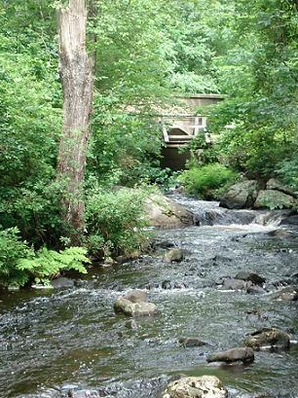
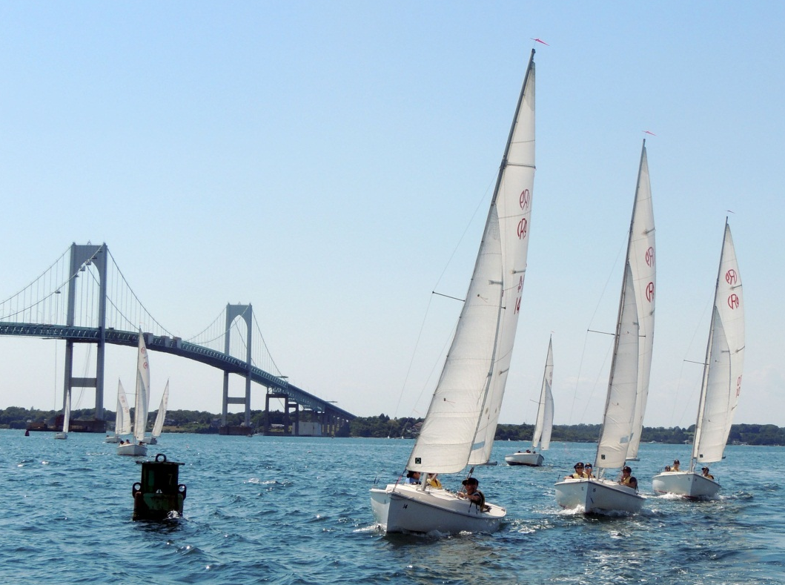
Regional Plan for Sustainable Development
A Sustainable Rhode Island
September 18, 2012

Slide 2
HUD Sustainable Communities
Federal Partnership for Sustainable Communities
Federal effort at “silo-busting”
Supports environmental and economic sustainability
Notes:
Offered through the Federal Partnership for Sustainable Communities
-HUD
-EPA
-US DOT
The sustainable communities regional planning grants support planning efforts that integrate the following:
-Housing
-Land Use-
-Economic Development
-Transportation
-Infrastructure Investment

Slide 3
HUD Sustainable Communities
SIX LIVABILITY PRINCIPLES
Provide more transportation choices.
Promote equitable, affordable housing.
Enhance economic competitiveness.
Support existing communities.
Coordinate and leverage federal policies and investment.
Value communities and neighborhoods.
Notes:
The partnership has created the six livability principles seen here. Every grant application and every grant product must address these six principles.

Slide 4
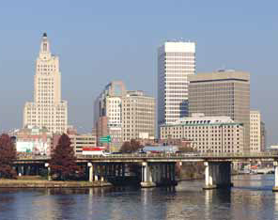
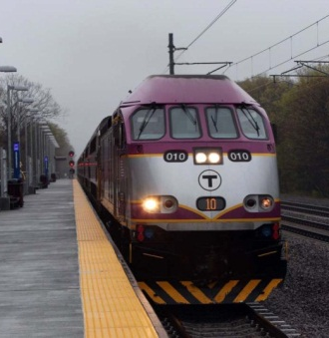
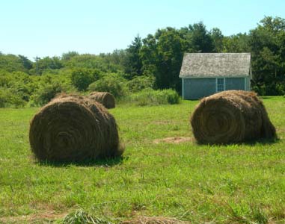
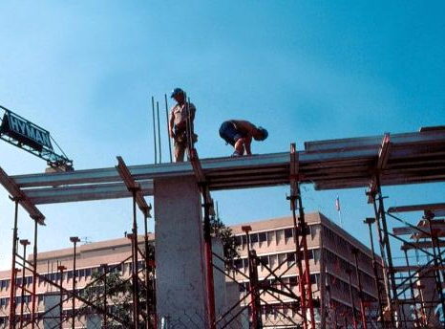
HUD Sustainable Communities
Sustainable Communities Regional Planning Grant
Nationally competitive
$1.9 Million from HUD over three years
Regional Plan for Sustainable Development
Notes:
RI Division of planning was awarded the grant in Fall 2011 and work got underway in early 2012. The outcome of the grant will be a regional plan for sustainable development for the state of Rhode Island.
The Division of planning is the fiscal agent for the grant and is joined in a grant consortium that includes other state agencies, municipalities and non profits.
State agencies: Rhode Island Housing, RIPTA, RIDOT, DEM, RIEDC, DOH
Municipalities: Cities of Providence, Warwick, Pawtucket, Cranston, East Providence and Newport, Towns of North Kingstown, Westerly & Burrillville
Non-Profits: RI Legal Services, RI LISC & Grow Smart RI
Specific tasks of our grant include:
-development of new statewide housing and economic development plans
-compilation of statewide data and mapping layers to create technical guidance that will help municipalities identify and define areas appropriate for growth and village centers.
-develop meaningful indicators and performance measures that can easily track RI’s progress toward sustainability and equity over time.
-establishment of a social equity advisory committee to represent underserved populations in the state and ensure social equity is infused in all plans.
-Utilize a public participation and communications strategy to reach target populations, engage them in the planning process and ensure sustained participation.
-Build capacity within state and local government and among participants in the planning process to implement sustainable development strategies from the plan.

Slide 5
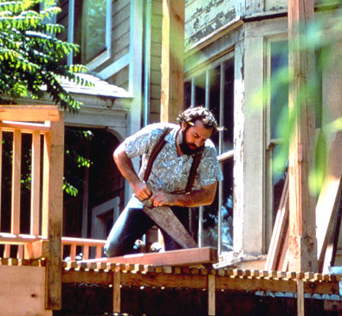
HUD Sustainable Communities
STATE HOUSING PLAN
Encompasses all of Rhode Island’s housing needs (subsidized and market rate).
Consolidation of existing plans
Regional Analysis of Impediments to Fair Housing
Notes:
Will be consolidating the two state housing plans (state strategic housing plan and affordable housing production plan) into a single plan that covers all of Rhode Island’s housing needs (both subsidized and market rate).
Will be creating a regional analysis of impediments to fair housing, with the cooperation of the six HUD entitlement communities in the state.
Challenges for the state housing plan:
-it’s an opportunity to readdress the states housing policies and regulations-a sometimes contentious, but important discussion
-it’s difficult to get people other than “housers” to be interested in the housing plan and we are working to ensure that other interests such as transportation, economic development and environmental management are at the table.

Slide 6
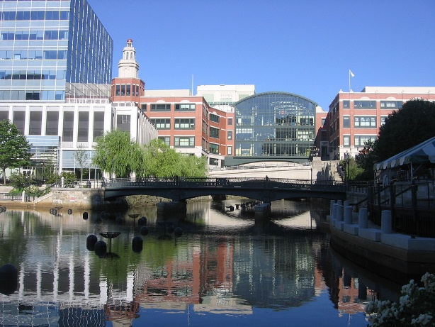
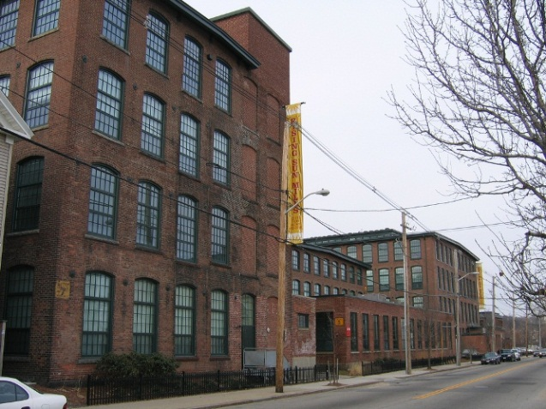
HUD Sustainable Communities
ECONOMIC DEVELOPMENT
Develop one economic development plan for Rhode Island.
Establish a vision and principles, as well as a framework for decisions on future investments.
Matt Ducke
Jef Nickerson
Notes:
The current state economic development plan is 12 years old. This new plan will replace the existing plan and will also consolidate the industrial land use plan.
We have also received additional grant funding from the US Economic Development Administration to make the state economic development plan serve as our federally required “Comprehensive Economic Development Strategy” or CEDS
This will be a place based economic development plan, this concept is not always embraced by those in the economic development field.
Place based etc. What is RI good at, what should we do? Recognize that BV is different than south county is different than east bay and west bay and that we should capitalize on those unique assets.

Slide 7
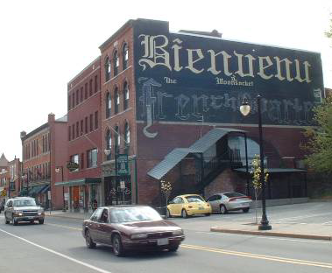
HUD Sustainable Communities
GROWTH CENTERS
Map Rhode Island’s resources and assets: natural, cultural, economic, and infrastructure.
Identify growth center types and help municipalities determine their location.
Notes:
Goal is to compile a series of mapping layers includes natural and cultural resources, economic development & infrastructure assets, existing growth center designations, etc.
Viewed together, these will help municiaplities make informed local decisions about where growth centers may be most appropriate.
This work is being coordinated with DEM’s statewide planning challenge grant on rural growth centers and an update of the states comprehensive planning guidebook.
Challenges with this work:
-even with all the mapping that will be compiled through this effort, municipalities will still have some difficult local decsions to make regarding how to balance and prioritizee the assets they wish to preserve and the assets they wish to build upon.
-promoting density is always a difficult conversation, whether urban, suburban or rural density. How do we talk about the advantages of density rather than density itself?
How do we determine the appropriate scale of growth centers in different contexts (for example, a growth center in North Smithfield is going to be different from a growth center in Narragansett, Little compton, providence or warwick.

Slide 8
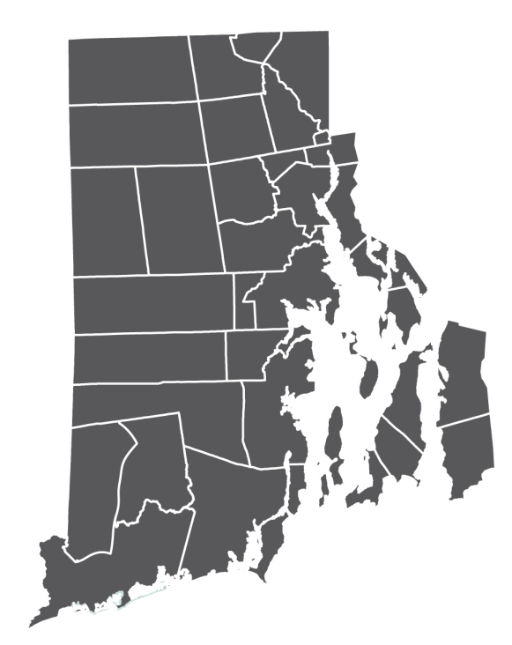
HUD Sustainable Communities
DATA AND PERFORMANCE MEASURES
Develop performance measures and indicators for the Regional Plan for Sustainable Development.
Bring together state’s data in a shared and accessible format.
Notes:
The goal is to develop indicators and measures to track the state’s progress on each component of the Regional plan for sustainable development.
We are working with other state agencies to determine what data each agency has, who works with it, can it be shared etc?

Slide 9
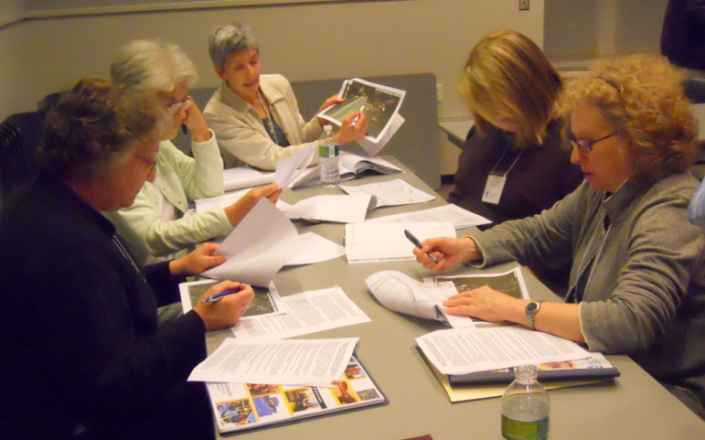
HUD Sustainable Communities
TECHNICAL ASSISTANCE AND
CAPACITY BUILDING
Determine the technical and capacity needs of Rhode Island’s municipalities.
Develop strategies, tools, and workshops to meet needs.
GrowSmart RI
Notes:
Another significant part of the grant is technical assistance and capacity building. This will be completed in two phases. SWP has recently completed interviews of all the municipal planners in RI to determine what and where the technical assistance needs lie. These results will be used to work with a consultant to create a first round of technical assistance and capacity building trainings to be given over the course of the next year to help our planners develop the skills they need.
The 2nd round of technical assistance will be developed through the results of the planning process and will be rolled out to planners and the public in the 3rd year of the grant.

Slide 10
HUD Sustainable Communities
INTEGRATED IMPLEMENTATION STRATEGY
Coordinated matrix of goals, strategies and actions from the Regional Plan for Sustainable Development
GrowSmart RI
Notes:
Using the HUD livability priniciples as a guide, the goals, strategies and actions contained in the Regional Plan for Sustainable Development (LU2025, Transportation 2030, Water 2030, the new housing plan, the new economic development plan, and the growth centers strategy) will be synthesized into an integration implementation program that will move RI from planning to action.
The implementation program will articulate short, medium and long term strategies that move the region toward sustainability. It will also assign responsible parties and provide cost estimates as feasible.

Slide 11
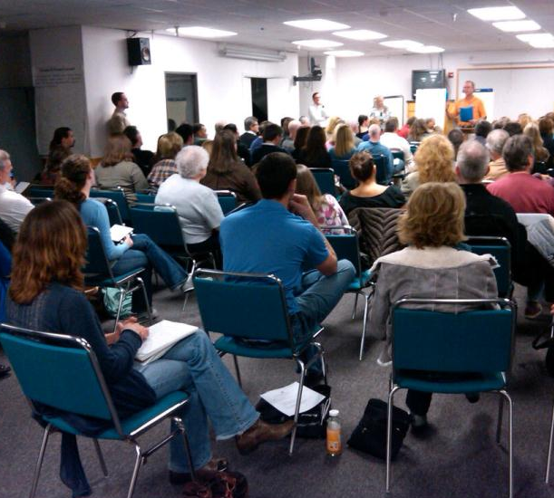
HUD Sustainable Communities
SOCIAL EQUITY AND ENGAGEMENT
Ensure planning processes and outcomes are equitable.
Focus on community engagement
Developing social equity principles for project.
Austin Post
Notes:
Part of the grant requires that we establish a social equity advisory committee. This committee will establish guiding principles for social equity throughout the planning process and will review existing plans and the newly developed plans to make sure that social equity is infused throughout.
We currently have a nomination process open for interested parties to serve on the social equity advisory committee. We are looking for RI residents who have an interest in equity issues as well as professionals who work in and on social equity issues.
We want to establish a social equity advisory committee that is balanced, representative and able to tap into existing networks throughout different communities in the state. We want the social equity advisory committee to be demographically and geographically diverse. The fact of the matter is that the majority of equity organizations in the state are located in Providence and the urban core. However, we recognize that there are equity issues throughout the state and want to make sure we have representatives who can bring those viewpoints to the table.

Slide 12
HUD Sustainable Communities
PROJECT SCHEDULE
Year 1
Community engagement and RFP development.
Year 2
Development of plans and public participation,
capacity building.
Plan adoption, capacity-building, and
implementation.
Year 3

Slide 13
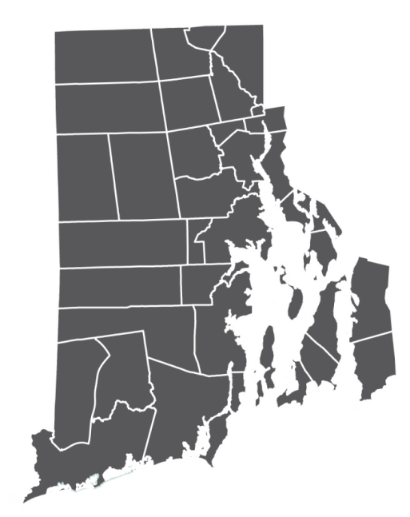
HUD Sustainable Communities
For More Information or to Get Involved
Melanie Jewett Army, AICP
Supervising Planner
222-6183 or melanie.army@doa.ri.gov
Chris Witt, Principal Planner
222-5759 or chris.witt@doa.ri.gov
Sustainable Communities Page of the Division of Planning Website:
http://www.planning.ri.gov/misc/communities/sustainable.html

