Slide 1
River Rescue Update 2012
Captain Robert Shields
Cumberland Rescue

Slide 2
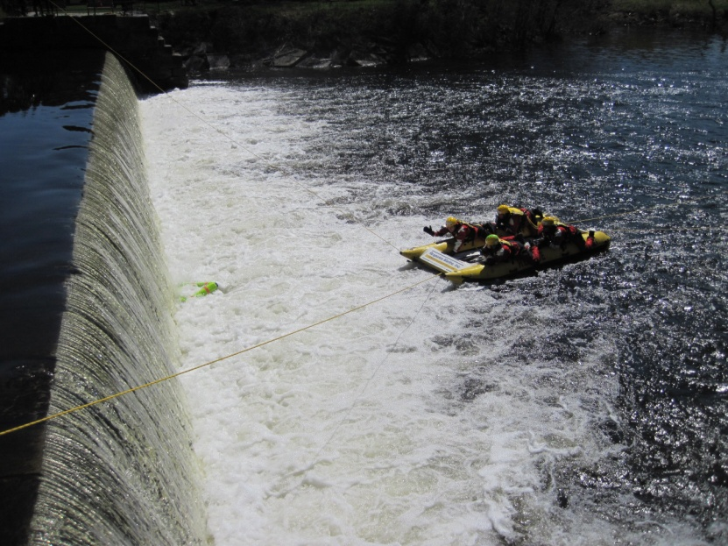
What's Up ??????
Blackstone Valley River Rescue Committee is officially disbanded
Team falls under The greater Woonsocket Fire Chiefs Association
Primary departments
Cumberland Rescue
Smithfield Fire

Slide 3
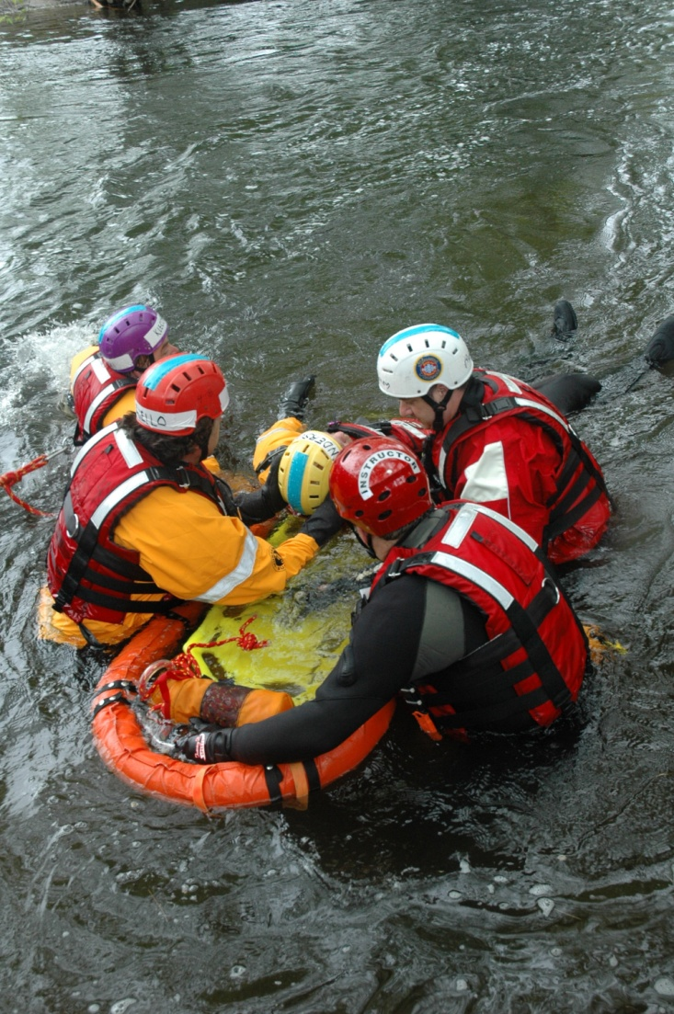
Benefits
Cover all of Northern RI
Enhance response
Coordinate dispatching
Adds more personnel
Ability to acquire more training

Slide 4
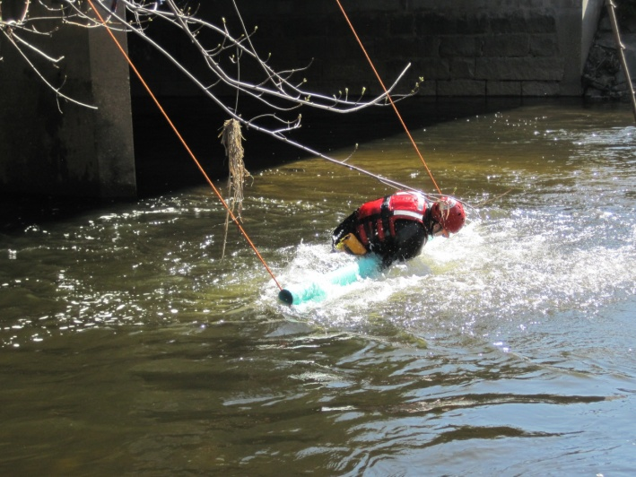
Effect On River Rescue Response
NONE!!!!!!
Cumberland is primary swiftwater rescue responder
Departments along river will receive:
Training updates annually
Pre-Plan updates annually
SOG updates annually

Slide 5
River Access
Blackstone River Pre-Plan
Based on sections from dam to dam or bridge to bridge
Notes:
Access points
Hazards
Staging areas
Special rescue considerations

Slide 6
RDC access, river left, north of dam
Staging area, behind Chemtex, Front St. Cumberland
Boat launch, south of Martin St. access from Hope Global driveway
Staging area, Hope Global driveway and parking lot

Slide 7
Signage????

Slide 8
Drowning Prevention
Currently updating public education classes
Hold sessions in late fall and early spring
Getting back into schools

Slide 9
WWW.NDPA.ORG

