Slide 1
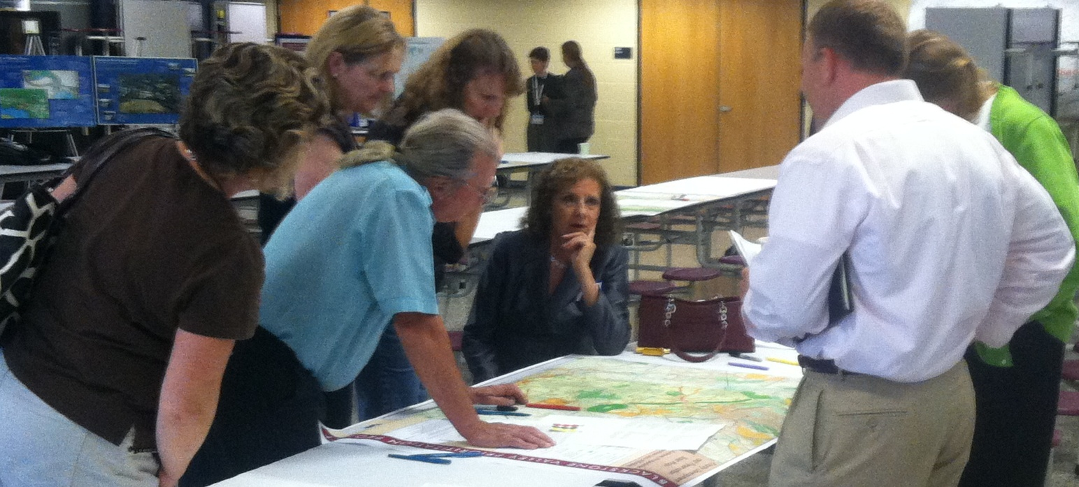
Blackstone Valley Prioritization Project
Blackstone River-Users Conference
September 18, 2012

Slide 2
About the Project
Funding: District Local Technical Assistance
Project partners: Central Massachusetts Regional Planning Commission Blackstone Valley Chamber of Commerce Blackstone River Valley National Heritage Corridor Commission
Scope: 11 towns
Objective: 30-year framework for land use and infrastructure investment in the region

Slide 3
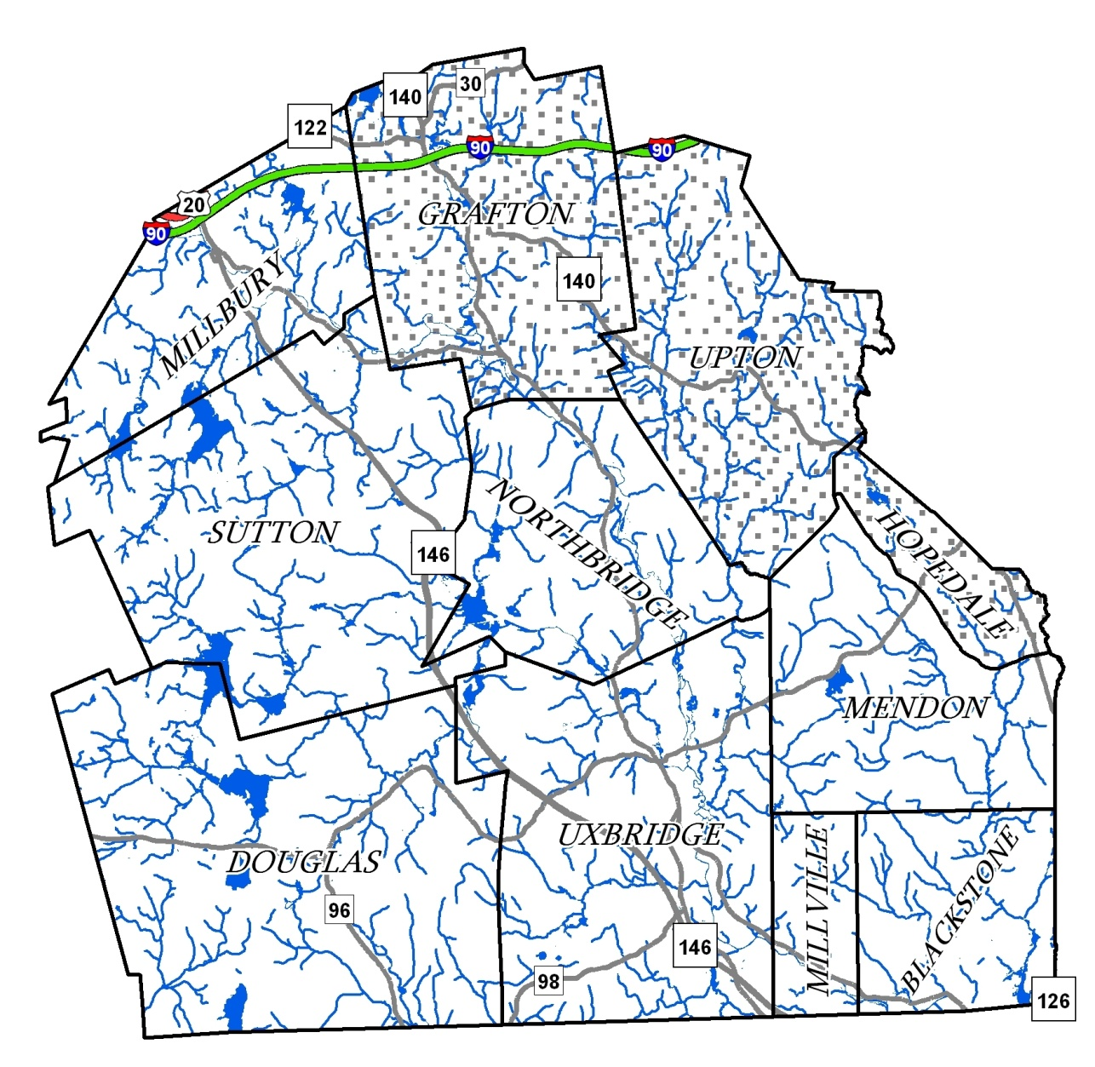
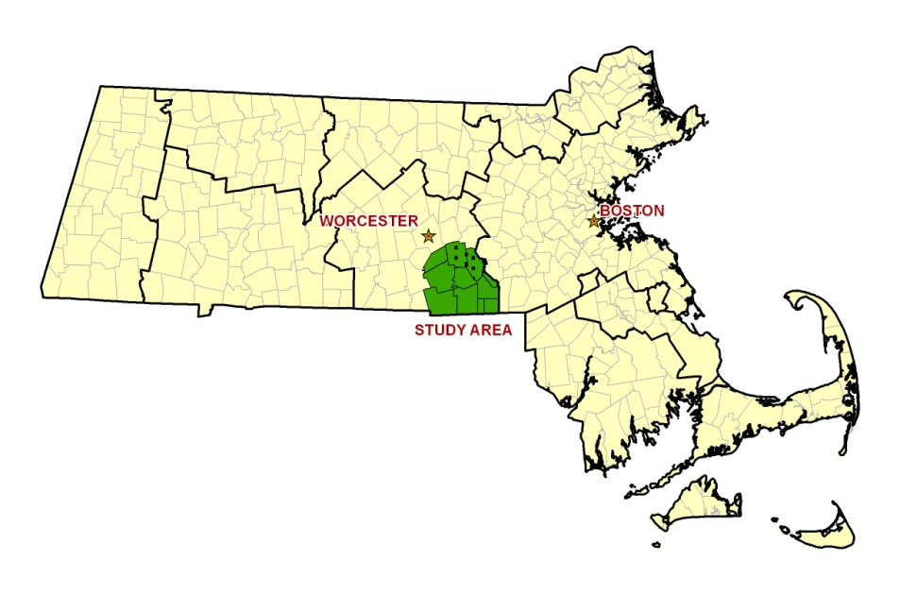
The Study Area: 11 Communities in the Blackstone Valley.

Slide 4
Fundamental Principles
New Growth will likely require transportation & infrastructure upgrades, beyond what is needed to maintain the existing systems.
New Commercial & Residential Growth must occur in a manner respectful of open space, water resources, & transportation networks.
Land use & transportation decisions must account for the Global Warming Solutions Act & the transportation reorganization statute.
Workforce housing must continue to be produced & preserved within the region at a scale that allows the number of workers living in the region to keep pace with the new jobs created.
Sustainable growth will involve the creation and maintenance of an effective public transit system coordinated with existing transit.
Coordinated planning & implementation efforts are necessary where jurisdictions and boundaries intersect.

Slide 5
Project Process
Create a shared framework for state, regional and local strategies for development, land preservation and infrastructure investments
Encourage Regional Context for Planning
Raise Awareness of Commonalities and Differences in Land Use Goals

Slide 6
Blackstone Valley Compact Regional Study Study Process and Timeline
Review of Previous Plans and Studies
March / April
Local Meetings
April / May
Community-Level Public Meetings
First Round of Regional Forums
June
Assessment and Identification
of Regional Priorities
July/ Aug.
Second Round of Regional Forums
Fall 2012
Project Conclusion and Final Report
Dec. 2012
Notes:
Bulk of our table exercise
Before we focus on that

Slide 7
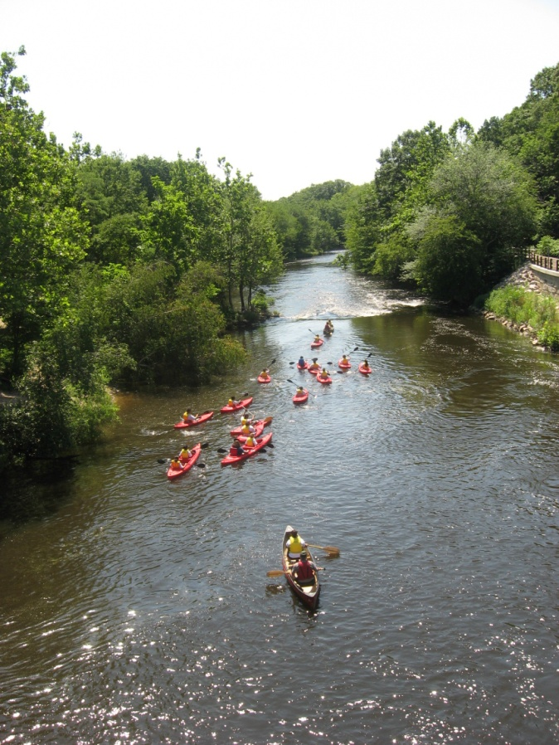
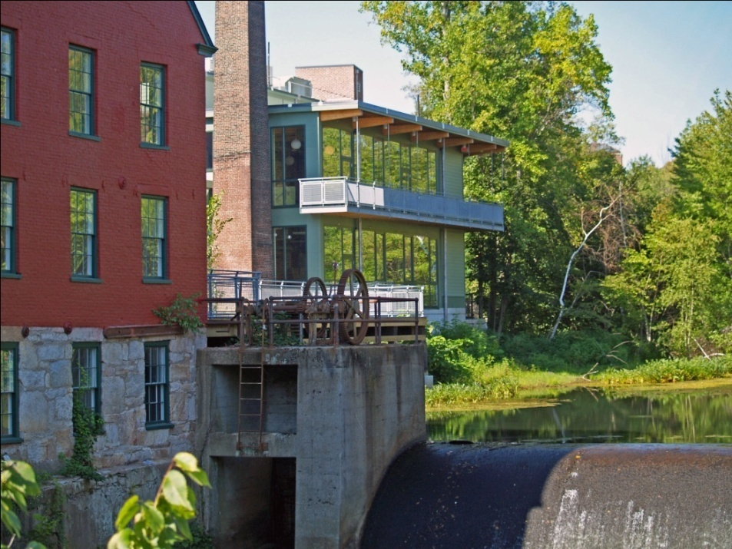
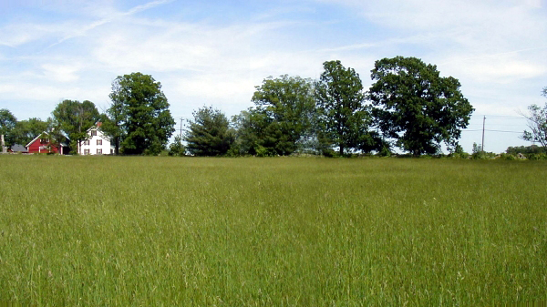
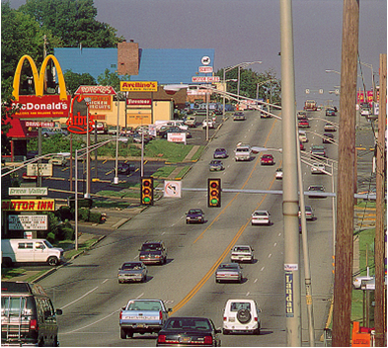
Priority Designations
Uses a Local Perspective to Identify:

Slide 8
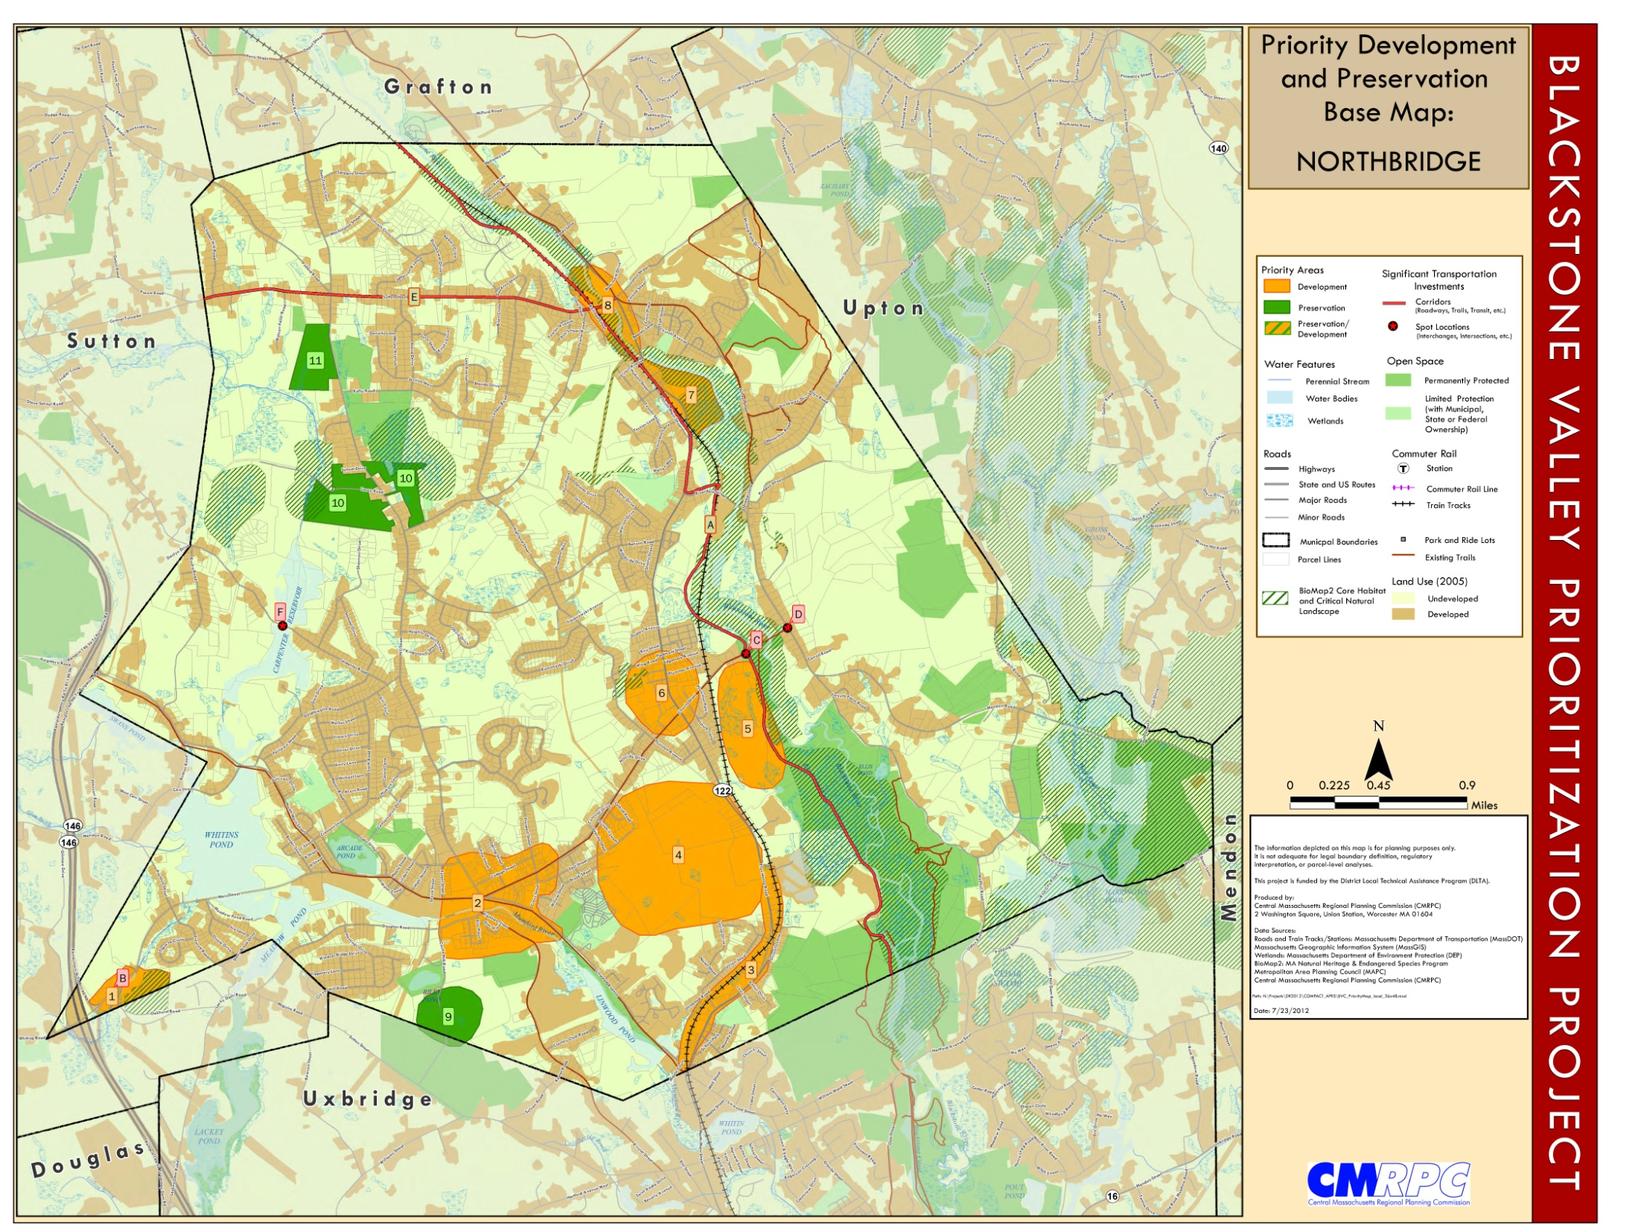

Slide 9
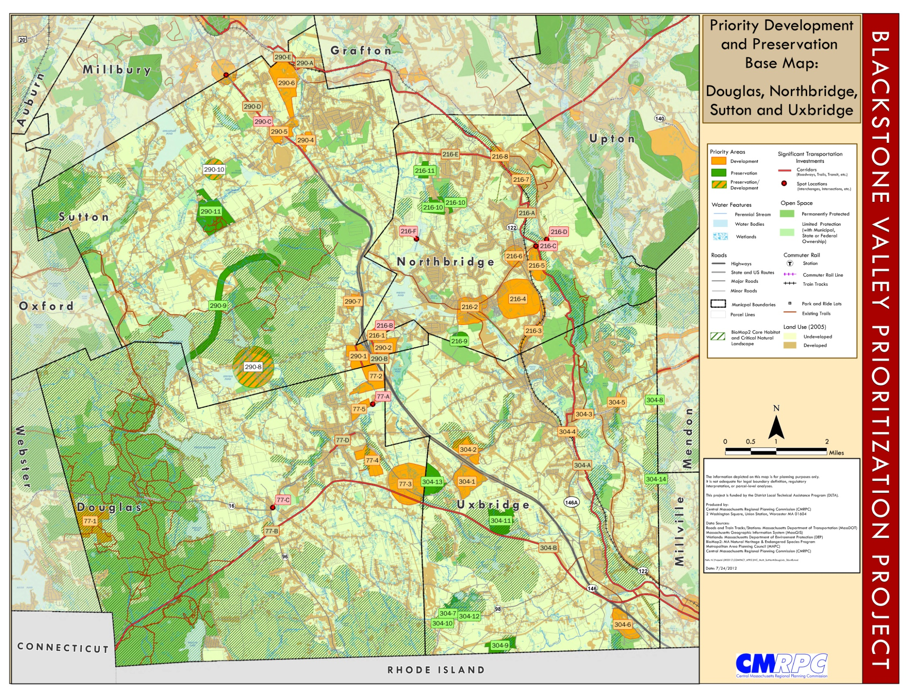

Slide 10
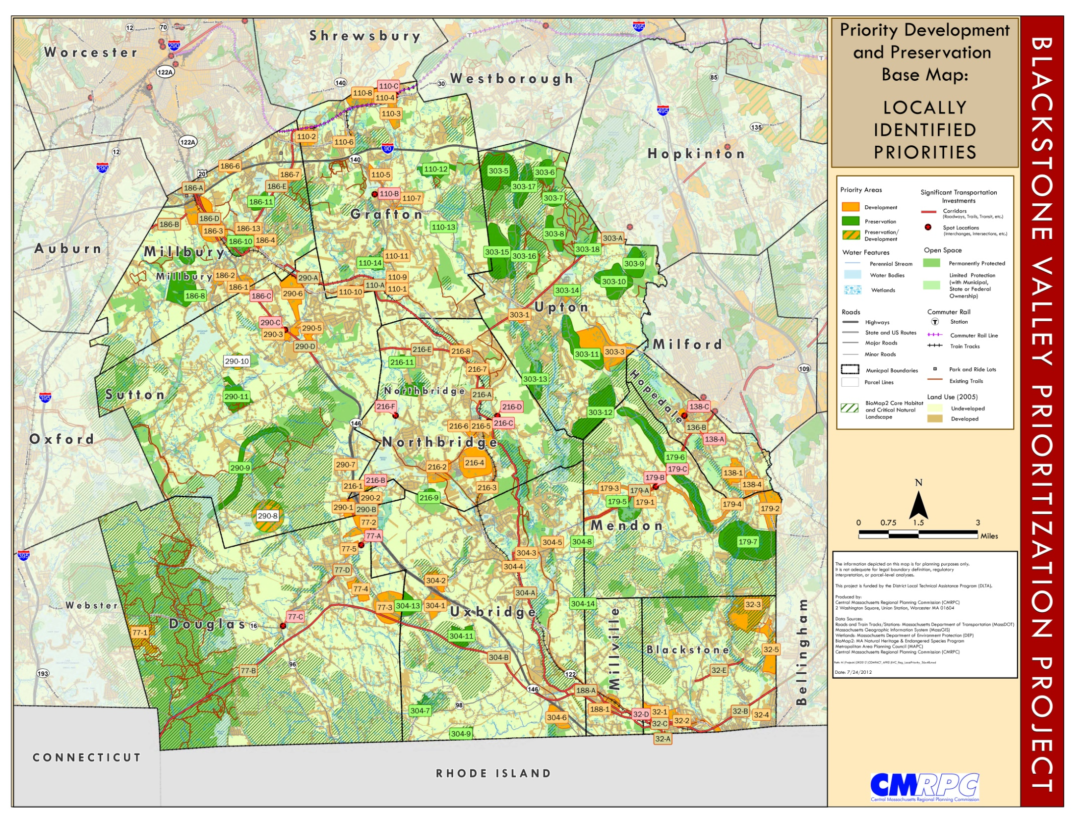
Notes:
BV Bikeway are priority transportation infrastructure.

Slide 11
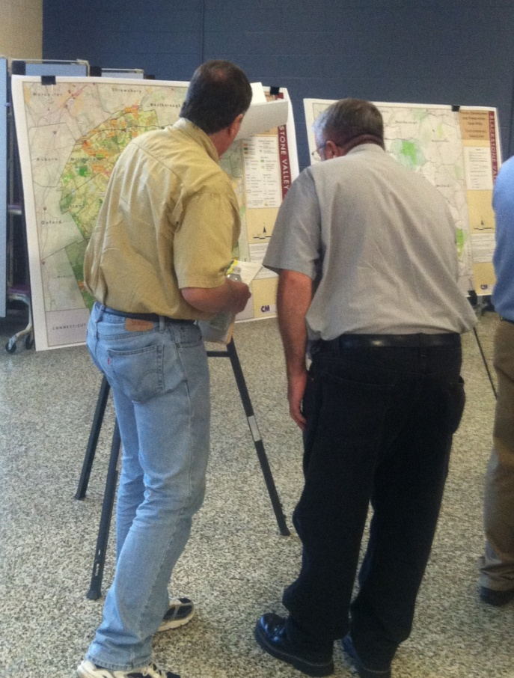
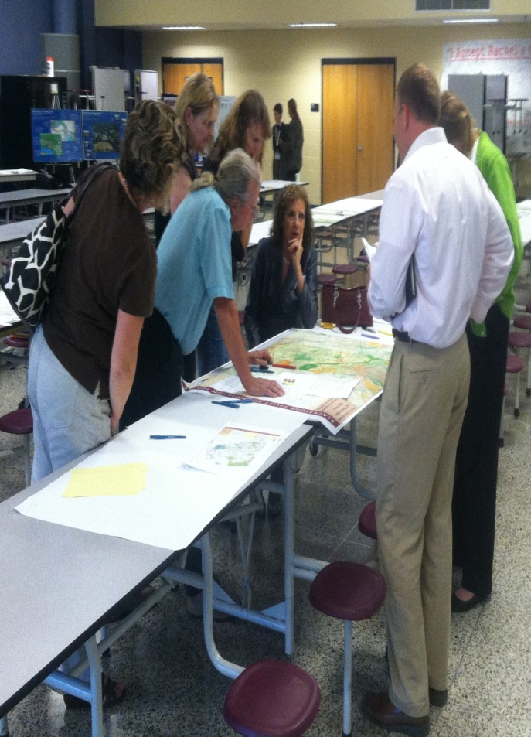
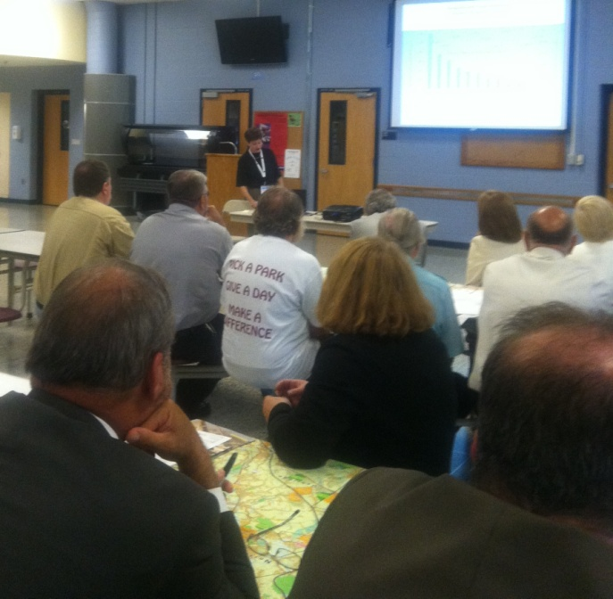
Regional Forum

Slide 12
Regional Screening
There are limited resources - financially, economically, environmentally
To better guide investment of these resources, a Regional Screening was performed on the local PDAs and PPAs
The screening was based on information and data that supported the six fundamental principles
Expert Roundtables part of the process
Local priorities will continue to be locations for growth and development and they are recorded on local maps created through this process

Slide 13
Regional Screening - GIS
Geographic Information System (GIS) data used to guide the screening included:
Developed Land
Housing
Chapter 40R, 43D and Economic Growth Districts
BioMAP 2
Wetlands
Floodplains
Impaired Streams
Populations meeting Environmental Justice Criteria (e.g., income, minority population, etc.)
Wellheads
Aquifers
Surface Water Supply Protection Areas
Sidewalks, Shared Use and Bicycling Facilities, Trails, Transit
Roadways and Interchanges
Farms
Prime Agricultural Soils
Historic Areas

Slide 14
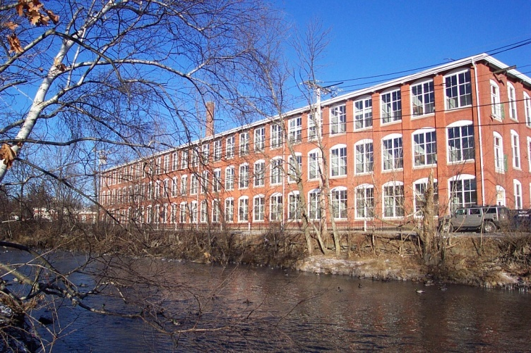
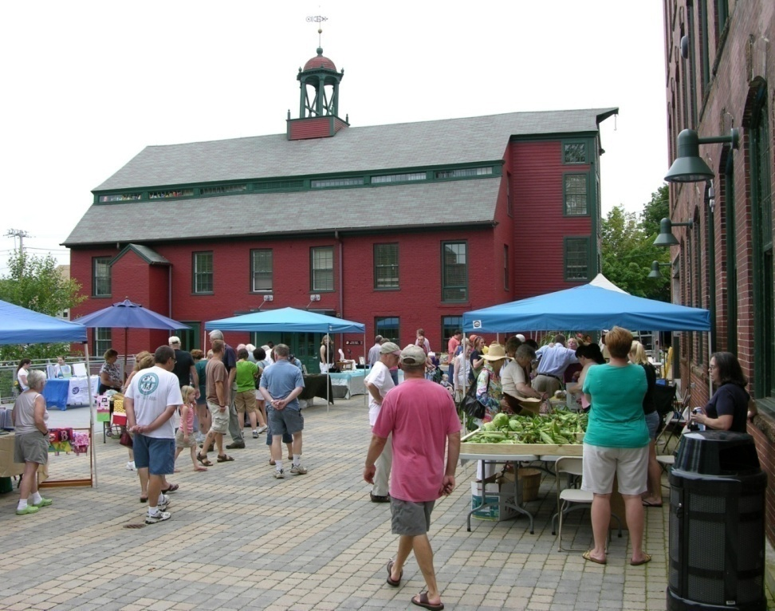
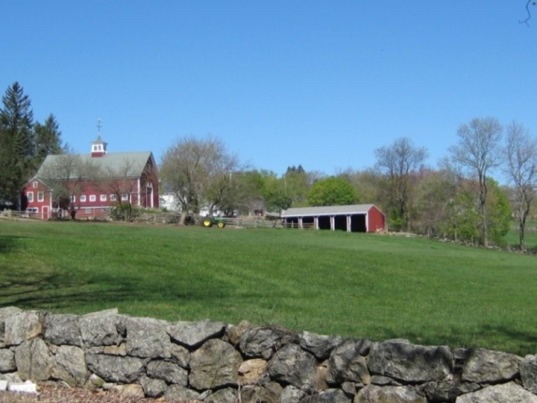
Regional Screening - Themes
Downtowns, town centers, and villages, should be centers for development
Mill redevelopment; adaptive re-use
Priority Heritage Landscapes
Route 146 – Parkway development

Slide 15
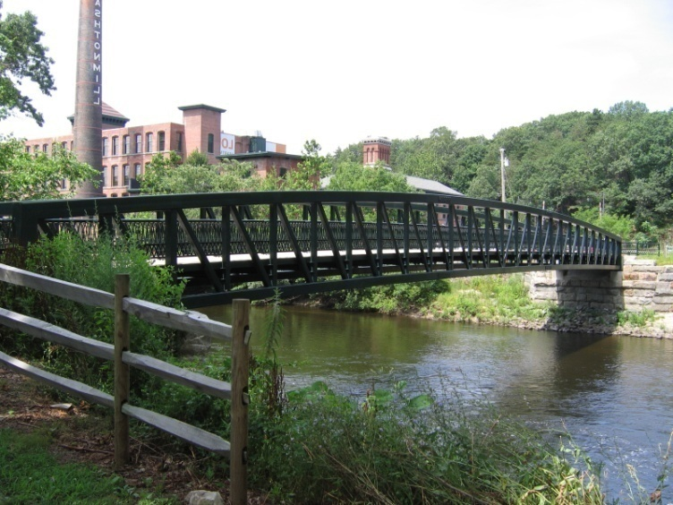
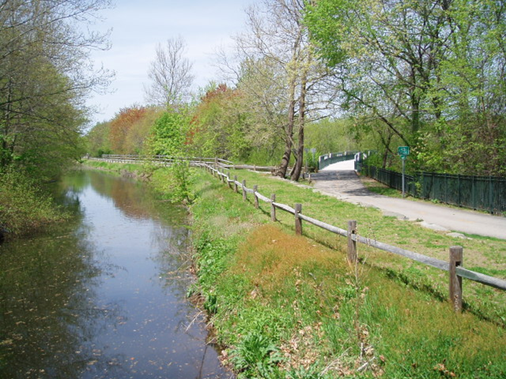
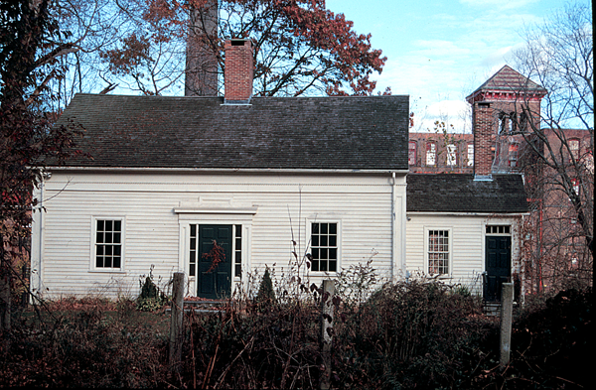
Regional Screening – Themes cont.
Interchanges as key transportation asset: Capacity to be protected
Working farms and farms with prime agricultural soils are assets
Connectivity between existing open spaces, clusters of identified PPAs
Blackstone River, bikeway, canal
Historic preservation

Slide 16
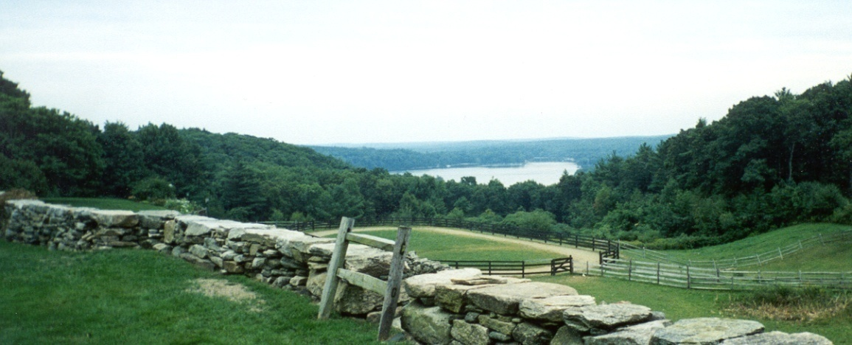
Next Steps
Transportation Model – dispersed growth vs. “priority” growth
November Regional Forum to present Regional Priorities
Final Report – December 2012
Learn more, get involved and stay up to date by visiting www.cmrpc.org/bvpp
Vera Kolias, AICP
vkolias@cmrpc.org 508-459-3322

