Slide 1
Blackstone River Bikeway Providence, RI to Massachusetts Border

Slide 2
Agenda
Introduction to the Blackstone River Bikeway, Rhode Island
Design Team Organization
Completed Bikeway Sections
Future Design Sections/Schedule

Slide 3
Project Purpose
To provide a safe efficient and continuous facility that encourages bicycle riding as an alternate means of transportation along the original transportation route of the Blackstone River and Canal between Providence and Woonsocket. It shall also connect historic sites, municipal centers, State and local parks, recreational facilities and scenic locations in the Blackstone River Valley

Slide 4
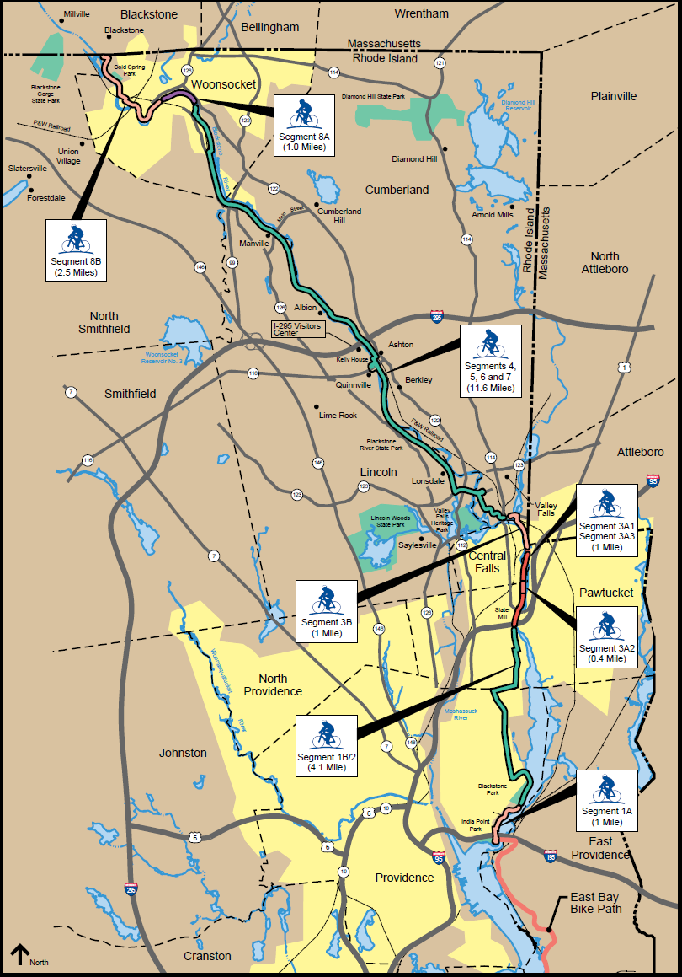
Overall Route within RI

Slide 5
Design Team
RI Department of Environmental Management – Division of Planning and Development (RIDEM – P&D)
RI Department of Transportation (RIDOT) Road Design and Bridge Sections
Vanasse Hangen Brustlin (VHB)

Slide 6
Design Team Roles
RIDEM – Overall design project management. Maintenance of the completed bikeway through the Division of Parks and Recreation
RIDOT – Design plan review, advertising and construction inspection. RIDOT also coordinates and controls funding
VHB – Prepare design and permitting plans

Slide 7
Completed Bikeway Sections
Planning Study completed/Final Design started 1993
Approx.11 miles of continuous separated facility built through 10 construction contracts
5 River and 2 Canal crossings, 3 miles of path along the Canal, 5 miles of rail-with-trail along the P&W RR,
4 miles of Bike Lanes and shared roadway in Providence and Pawtucket

Slide 8
Segment 1B/2, On-Road Bikeways/Bike Lanes Prov/Pawtucket

Slide 9
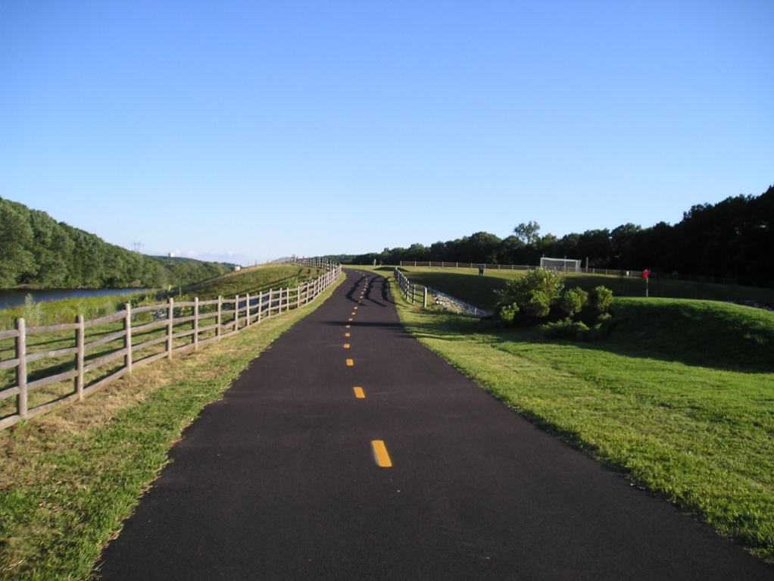
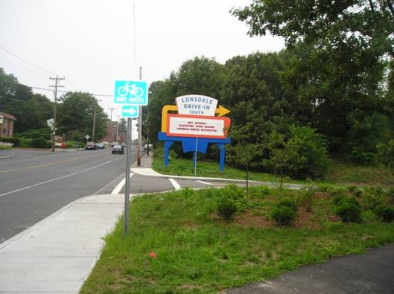
Blackstone River Bikeway – Completed Segments 4A, 4B, 5, 6, 7

Slide 10
Future and Current Design

Slide 11
Future and Current Design
Segment 8A – From Rivers Edge Recreational Park to the Truman Drive/Main Street Intersection
30% design complete and being reviewed
Right of Way process starting

Slide 12
Future and Current Design
Segment 8B – From Truman to Cold Spring Park
Beginning 30% design, several areas require coordination with the City

Slide 13
Future and Current Design
Segment 8C – From Cold Spring Park to the Massachusetts state line
Beginning 30% design
30% submission and ROW process anticipated December 2012

Slide 14
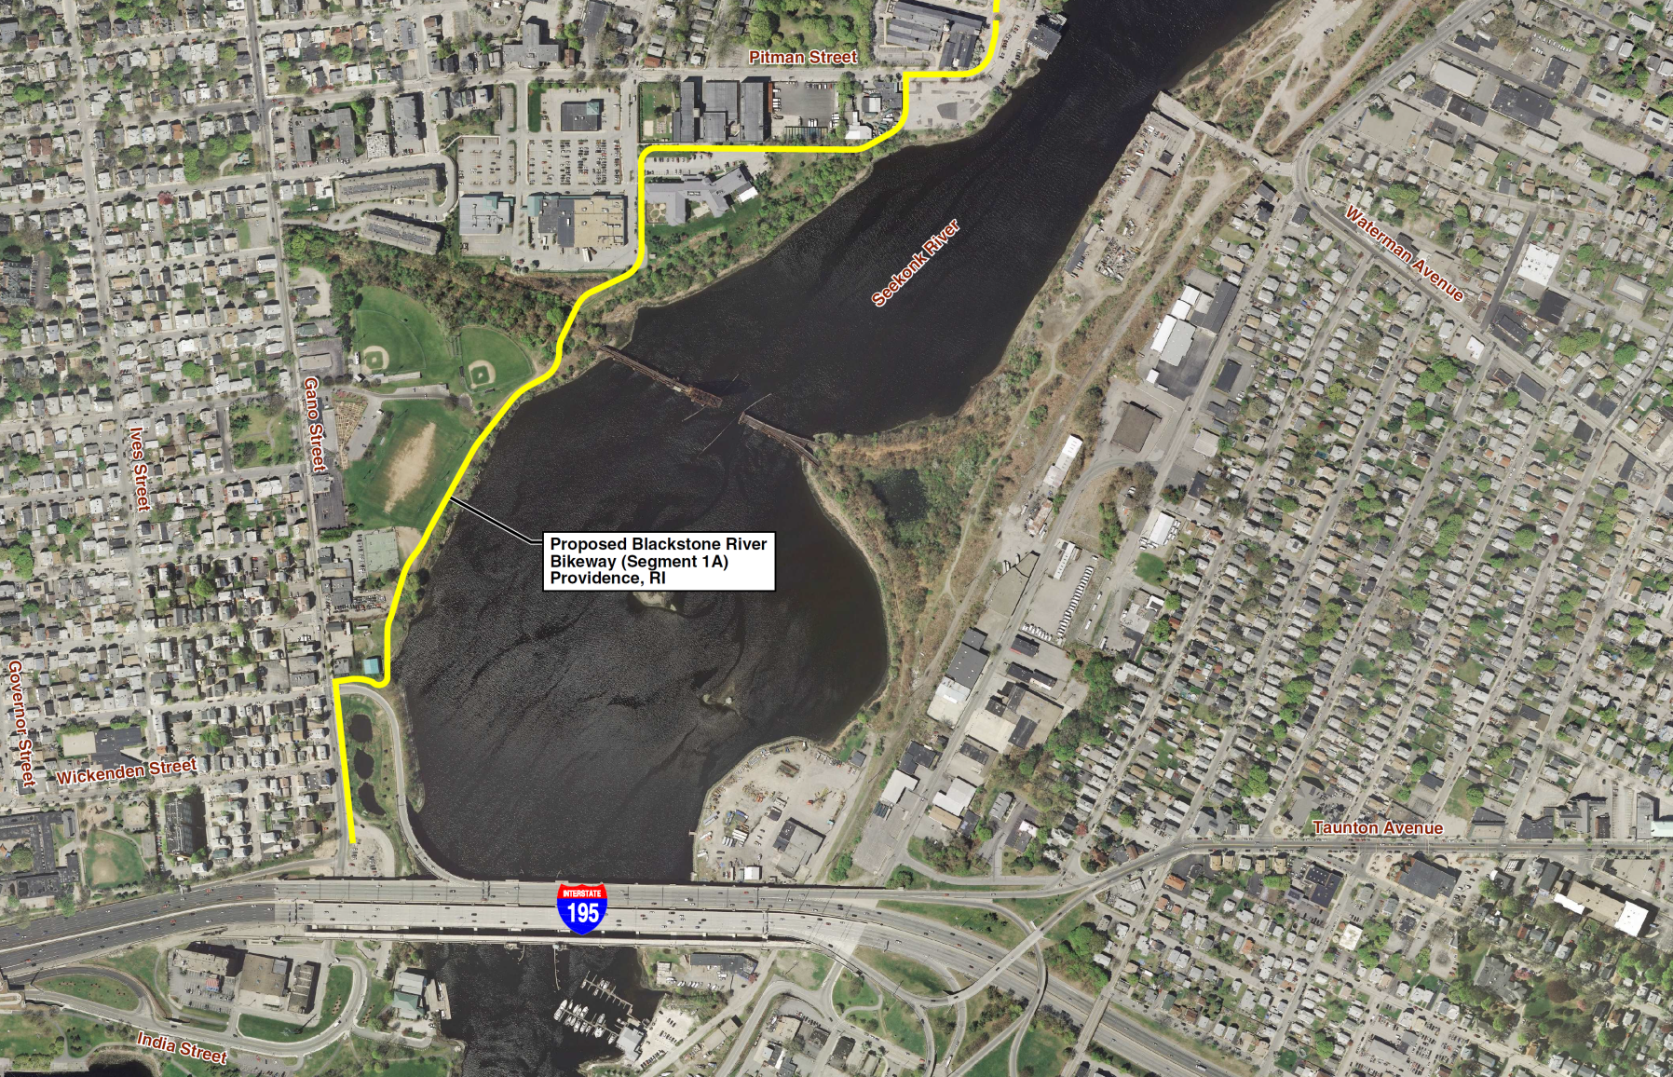
Future and Current Design

Slide 15
Future and Current Design
Segment 1A – From I-195/Gano Street ramp to Pitman Street
A Scope of Work and design fee has been submitted and is being reviewed
Authorization to proceed anticipated January 2013

Slide 16
Future and Current Design
Segment 3A – Pawtucket
Pawtucket Landing northerly to Branch Street
Segment 3B – Central Falls
Branch Street, Pawtucket to Broad Street, Central Falls
Conceptual Design and Alternatives Analysis

Slide 17
Planning the MA/RI Connection

